Slide 1
Project 60: Fundamentals of Recrystallization in Binary Nb Alloys
Spring CANFSA Meeting
Sept 2023
Student: Will Waliser (Mines)
Faculty: Amy Clarke and Kester Clarke (Mines)
Industrial Mentors: Noah Philips, Matthew Carl (ATI)

Slide 2
Project 60: Fundamentals of Recrystallization in Binary Nb Alloys
Student: Will Waliser (Mines)
Advisor(s): Amy Clarke, Kester Clarke (Mines)
Project Duration
PHD: September 2021 to May 2025
Problem: Hf additions have been shown to increase recrystallization temperatures in Nb alloys, but alternatives that produce similar effects have not yet been identified.
Objective: Identify binary and/or ternary Nb alloys of interest and experimentally measure recrystallization parameters and microstructural evolution with thermomechanical processing.
Benefit: Improved performance of superconductors and/or refractory multi-principal element alloys (RMPEAs).
Recent Progress
Strain & Temp effects on deformation of C-103
Mechanical data, Hot deformation processing maps, LOM , EBSD, grain sizes, hardness data
Mentallographically prep’d for the writing process
Gleeble compression tests on all 2 wt.% binaries
Hardness values recorded for 60% reduced material
Rolling: tilt cast ingot and machined plate (CP Nb)
Metrics
Description | % Complete | Status
1. Literature review | 50% | ●
2. Select and obtain/produce binary and/or ternary Nb alloys | 40% | ●
3. Thermomechanical processing and heat treatment of as-cast materials | 30% | ●
4. Assess recrystallization temperatures and kinetics via heat treatment experiments | 5% | ●
5. Microstructural characterization of thermomechanically processed samples | 5% | ●
Notes:
Two primary applications of niobium use require the use of HF as an alloying element, and use it for strength and to increase recrystallization temps. Hf constrained resource, which might limit production scale of these alloys. In order to avoid this were going to investigate a number of promising of cost effective alloying elements by creating a series of binary and ternary Nb alloys and measuring thermomechanical response as a function of composition and processing parameters, as well as the effect on recrystallization, microstructural evolution and texture development.
Recent progress, casting melting, gleeble stuff, rolling, ht, analysis, finish

Slide 3
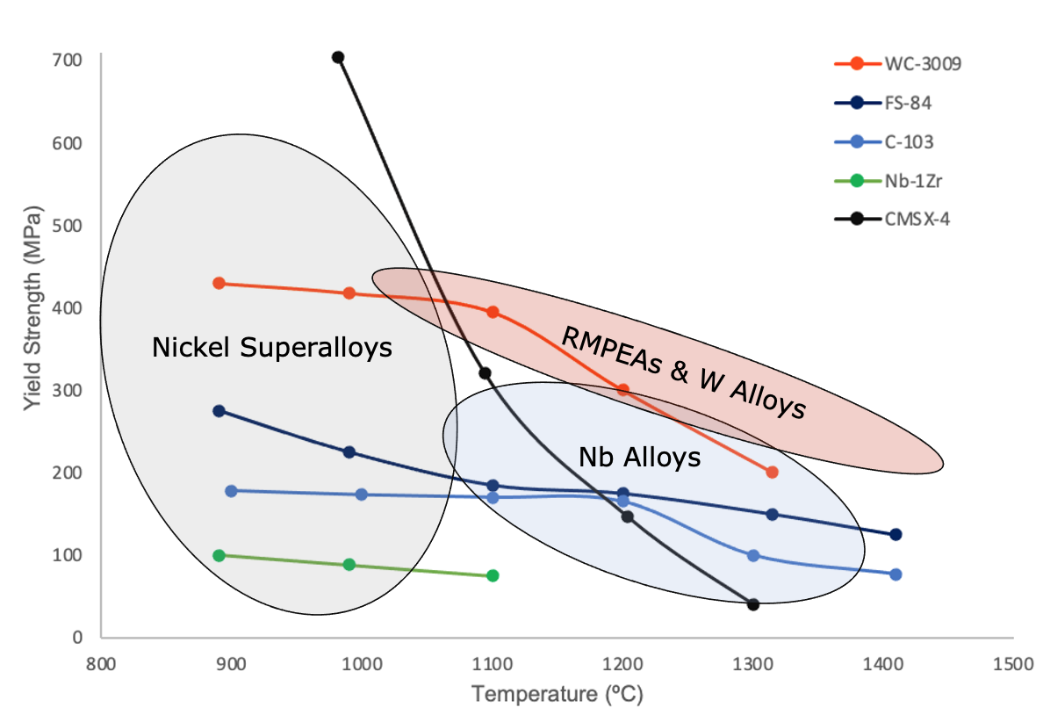
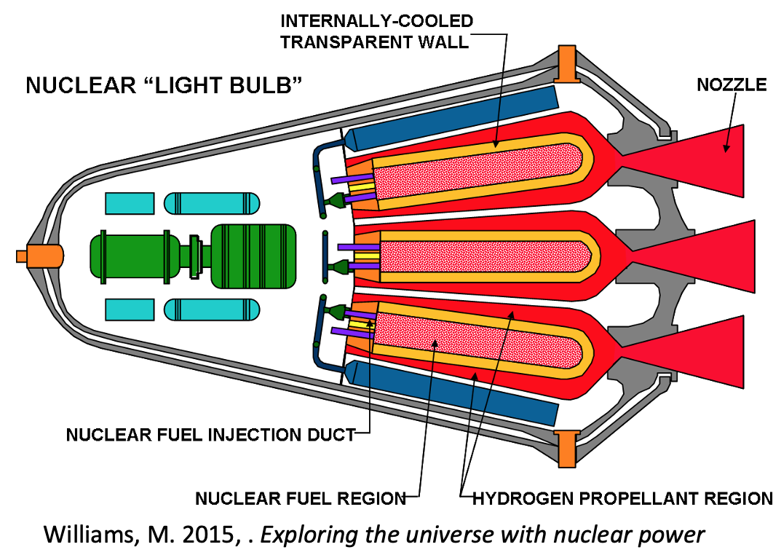
Industrial Relevance: Design of Lightweight RMPEAs
Refractory alloys favored for high temperature structural applications
C-103: favored for fabricability → 10 wt.% Hf + 1 wt.% Ti
Cost-effective refractory systems enable further improvements in propulsion technologies → important for continued space presence
[7] Sengupta et al. 1994, Western alloys 2022
[11] Williams, M., Phys.org. (2015)
Notes:
Bulk of refractory knowledge comes from 50-70s,
EXPLAIN THAT C-103 ONLY SURVIVED BECAUSE OF ITS LOW STRENGTH HIGH FABRICABILITY
FURTHER DEVELOPMENT OF REFRACTORY SYSTEMS FOR SPACE APPLICATIONS NEED EMPHASIS ON COST EFFECTIVENESS, LIGHT WEIGHT

Slide 4
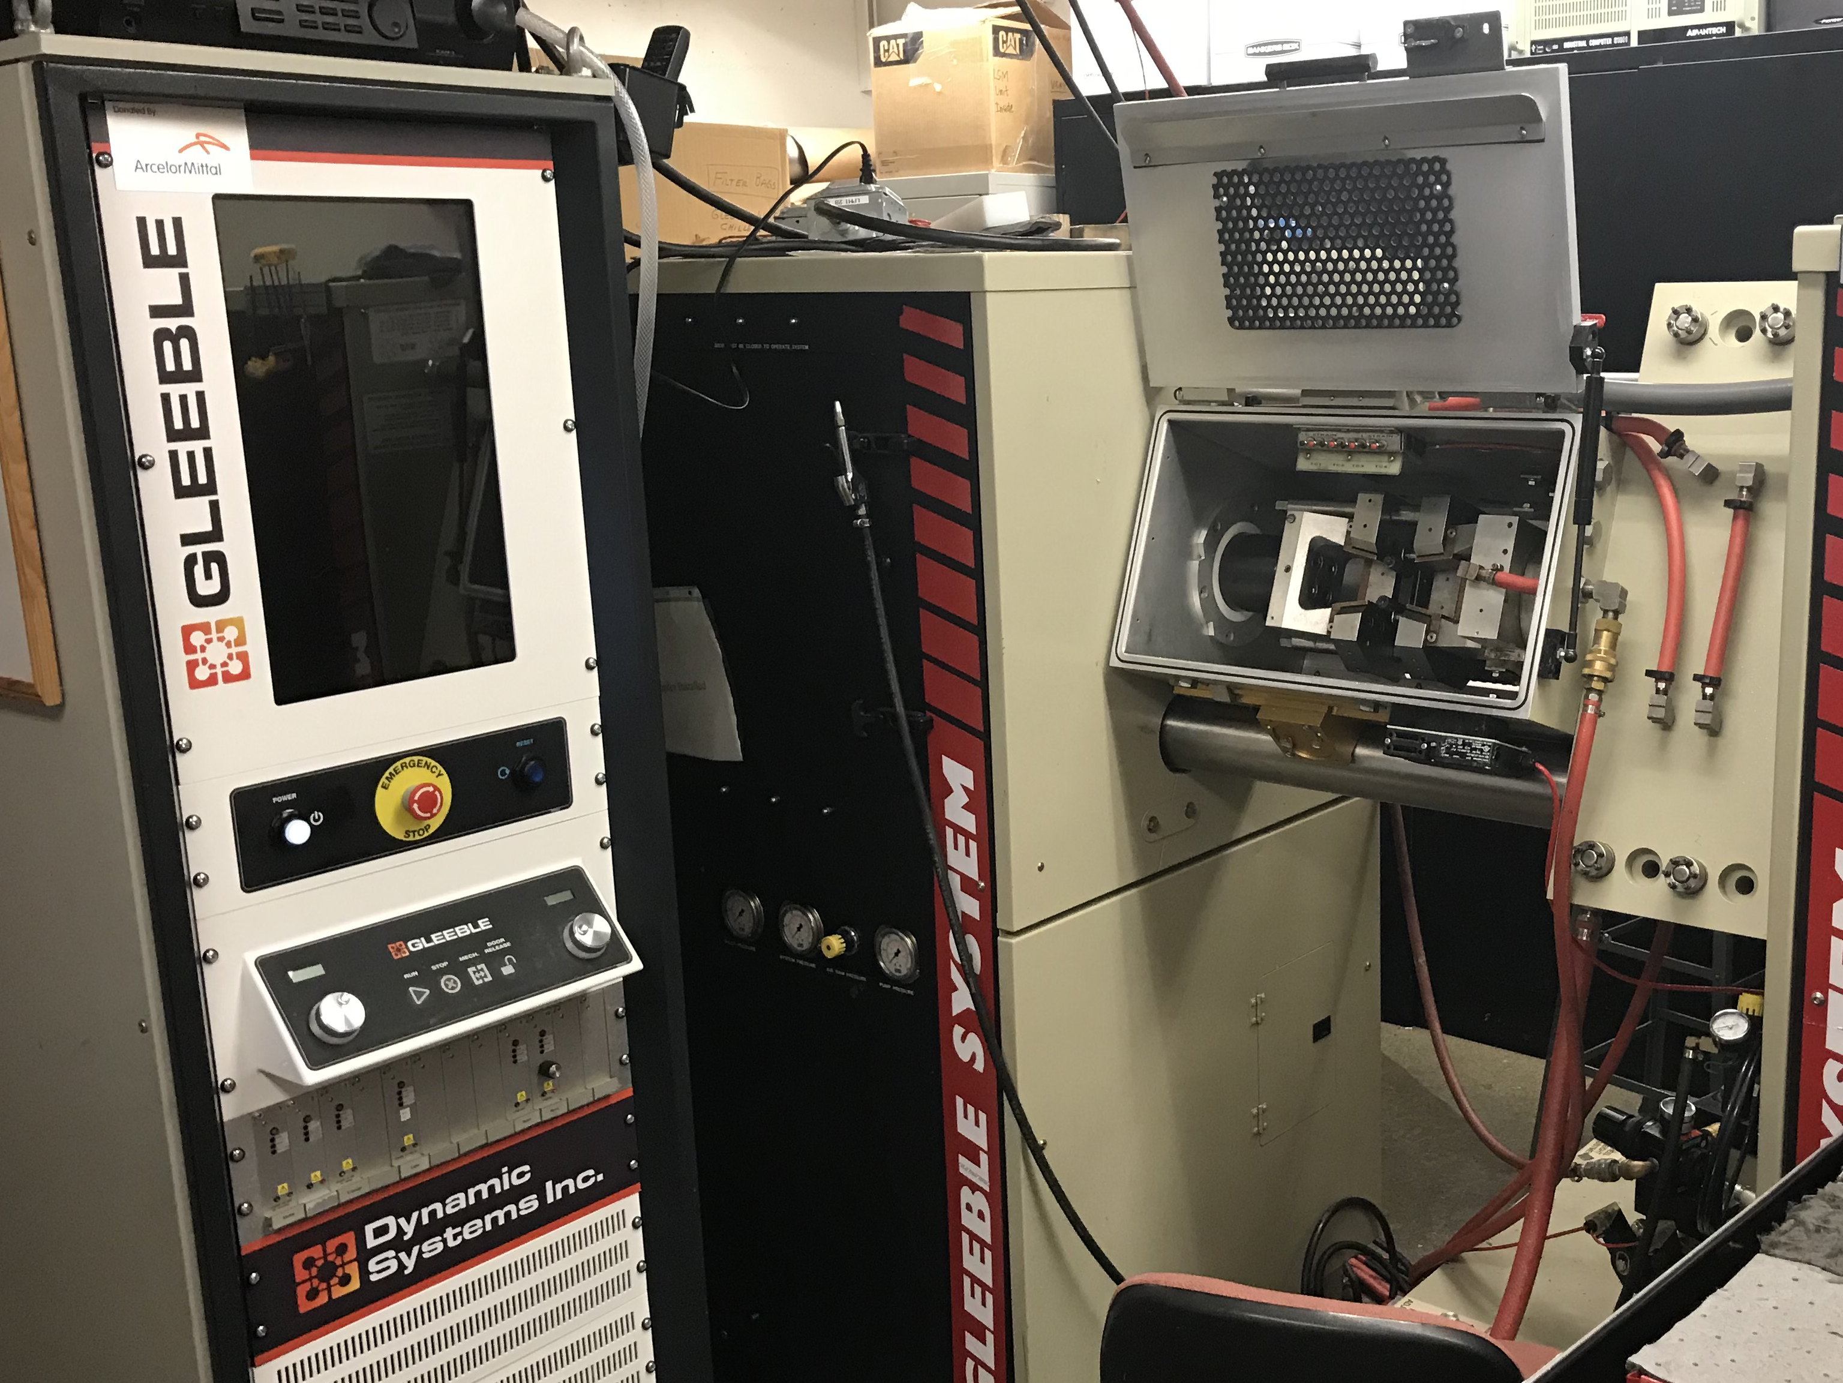
Deformation Testing: Gleeble comp. C-103
Compression tests
Workability, flow stress, oxygen pick up
Temperatures
400, 550, 725 °C
Strain rates:
10⁻³, 1 , 10 s⁻¹
Reduction: 60%

Slide 5
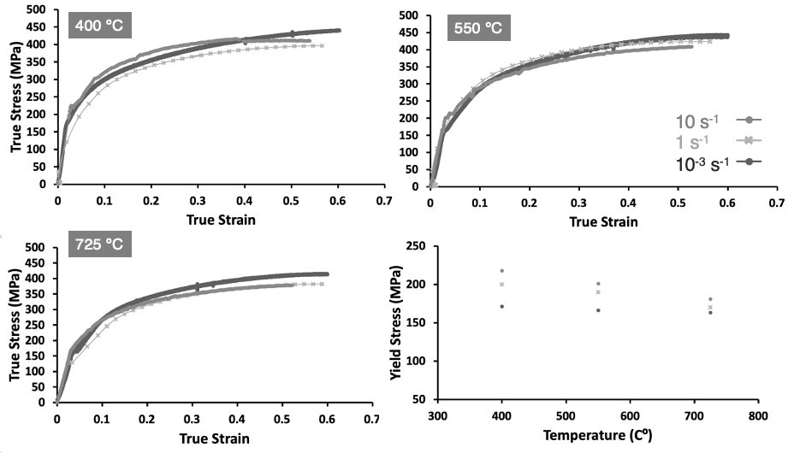
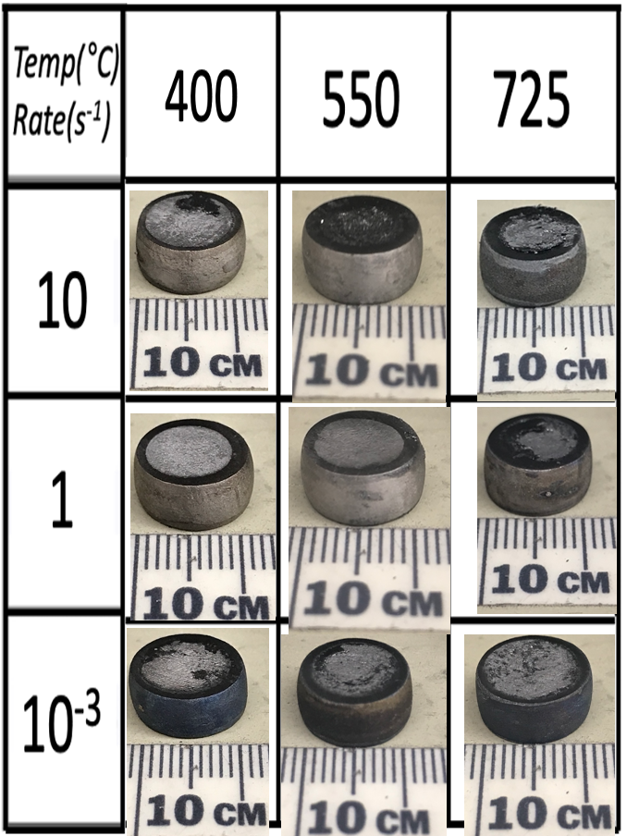
Gleeble Mechanical Data for Wrought C-103

Slide 6
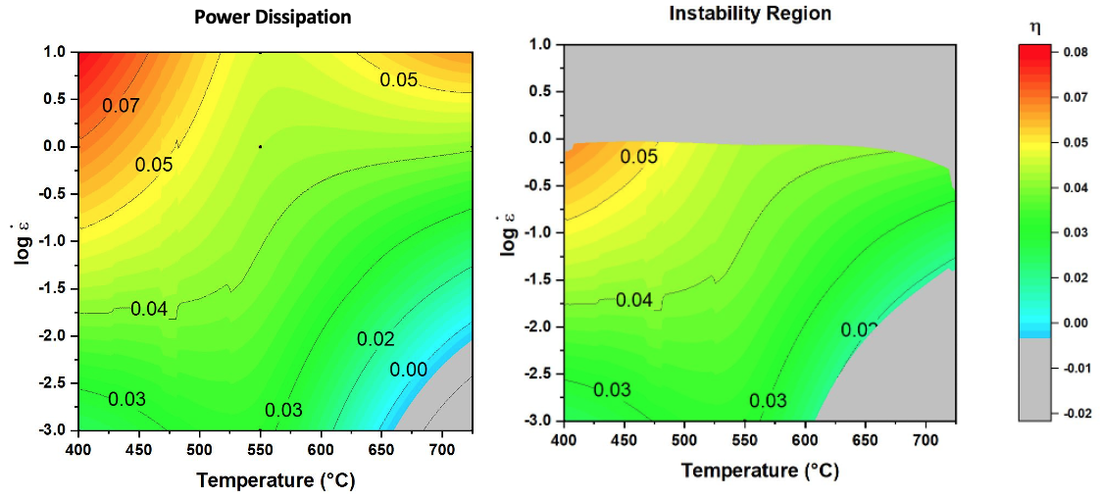
Hot Deformation Processing Map for Wrought C-103

Slide 7
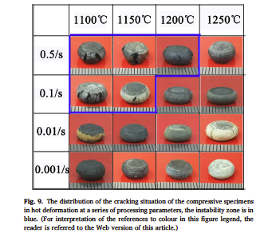
Instability region?
←literature data for MoNbHfZrTi alloy [15]
Instability more accurately maps to poor processing regions→ Cracking
Data for Wrought C-103→
Matrix is 3x3
Less data = less reliable

Slide 8
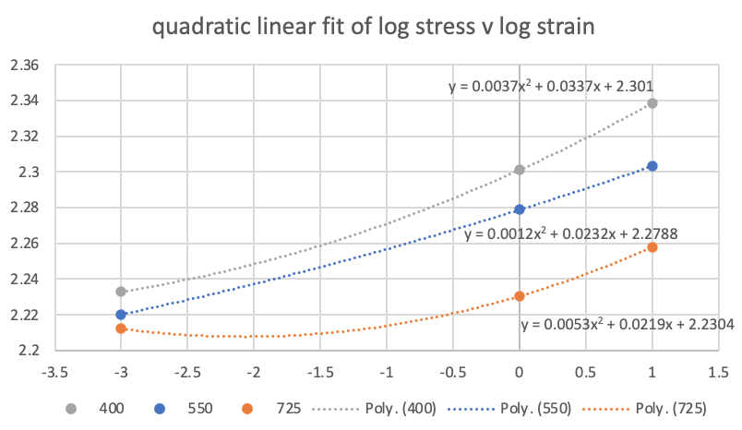
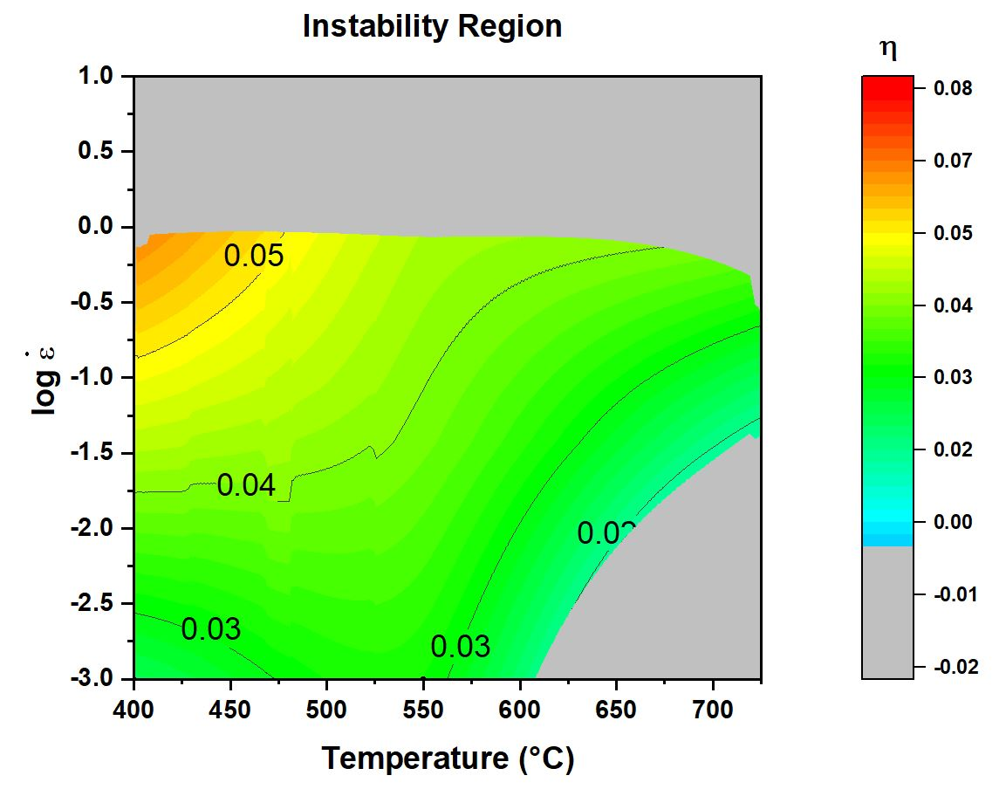
Instability region? Unreliable-fit region
←literature data for MoNbHfZrTi alloy [15]
Data set used to plot processing map was 4x4 matrix leading to cubic linear fit for data
This data →
is for wrought C-103
Matrix was 3x3
Quadratic linear fit
Less data = less reliable

Slide 9
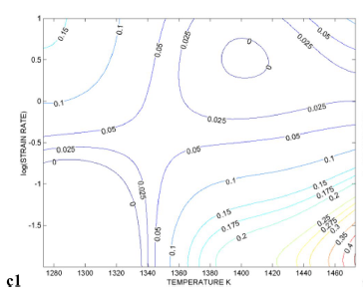
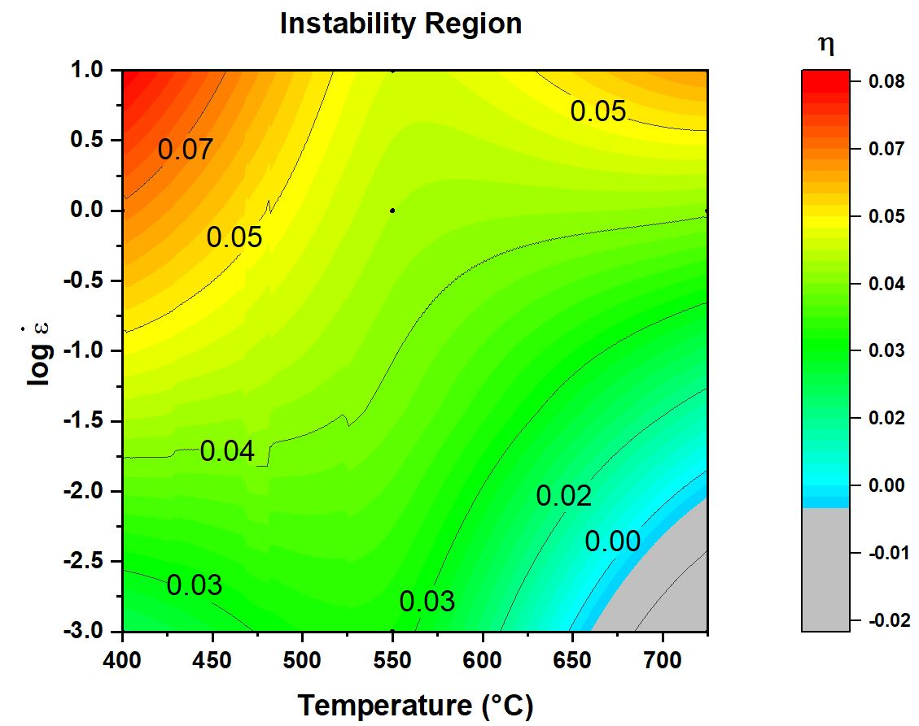
Power dissipation comparison for C-103
=0.6
=0.5
Power Dissipation
Comparison w/ literature Gupta [14]
Higher temps and lower strains

Slide 10
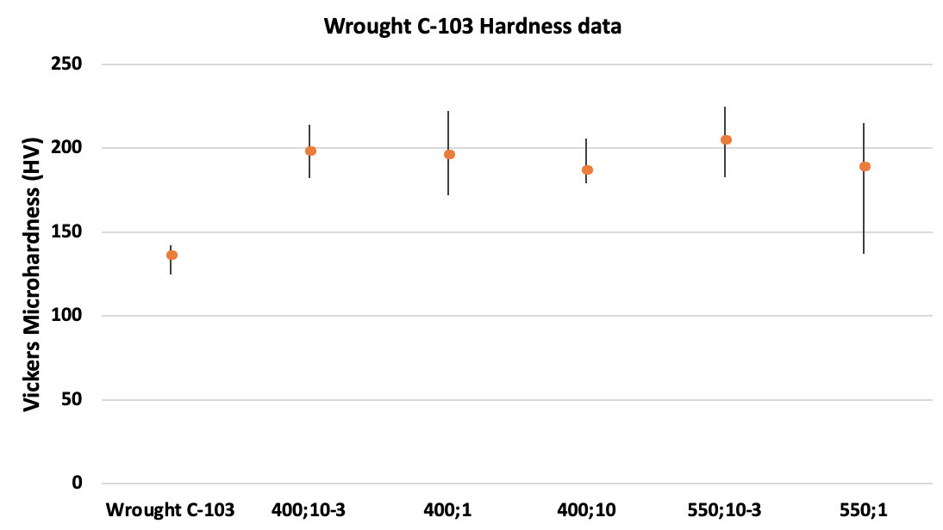
Wrought C-103 Hardness Data
5x5 grids, 500 g load, center of samples

Slide 11
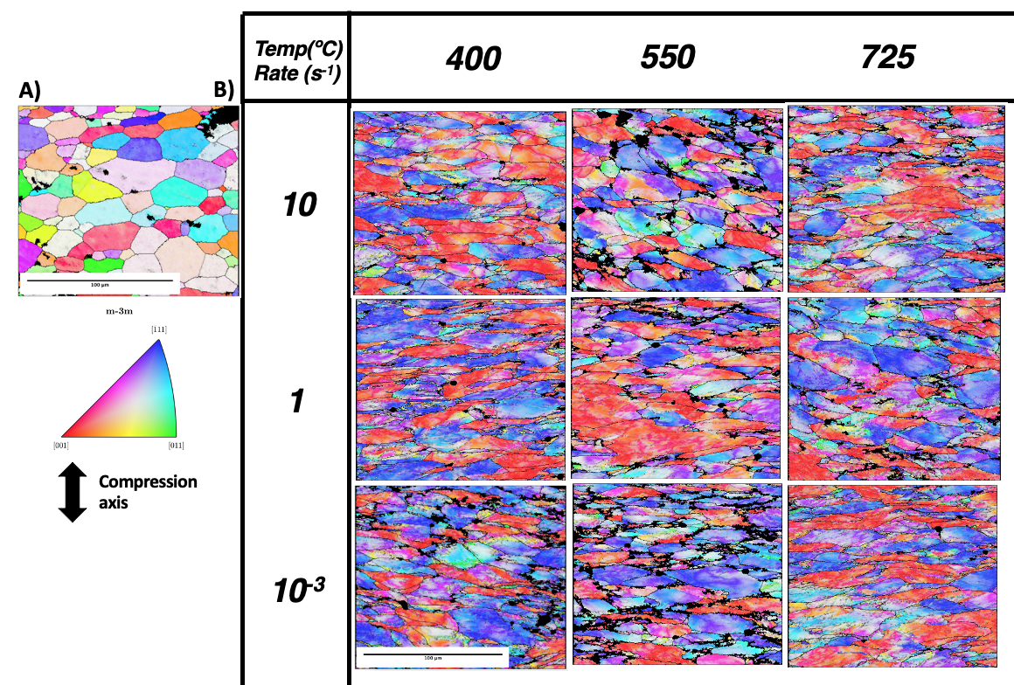
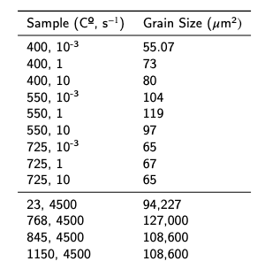
Microstructural Evolution: EBSD of Wrought C-103 & Grain sizes
Image area

Slide 12
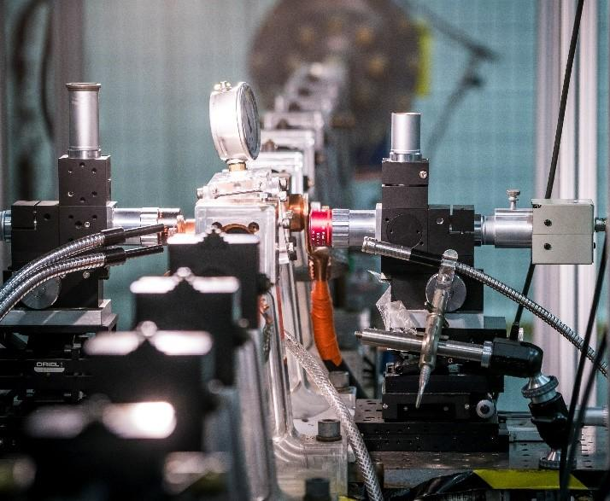
Deformation Testing: C-103 Kolsky samples
C-103 high strain rate compression tests
4500 s⁻¹
RT to 1213 ºC
Tests performed prior to program @ NIST
Thanks to Steven Mates
[13] Mates, S., 2020, Kolsky Facility

Slide 13
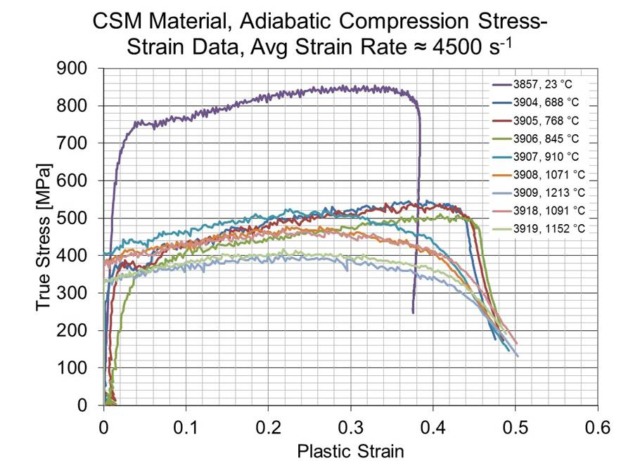
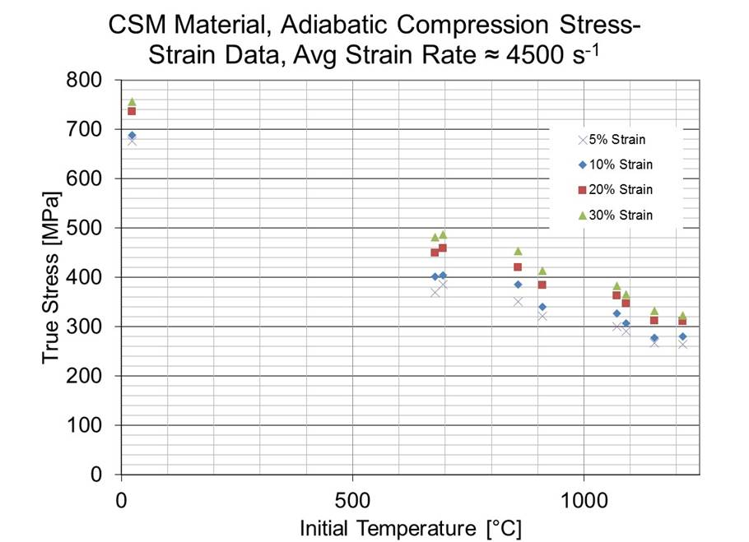
Deformation Testing: C-103 Kolsky samples

Slide 14
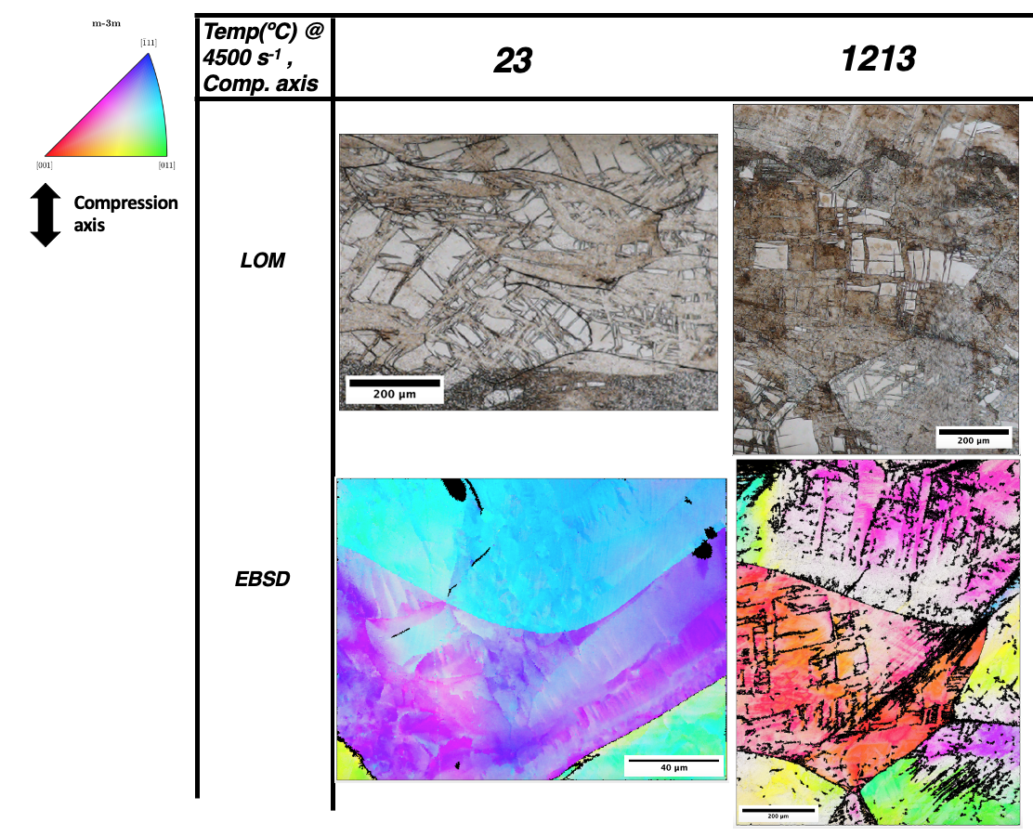
Kolsky bar C-103: LOM and EBSD of temp extremes
Gray studies on BCC high strain rate:
Increase strain rate = decreasing temperature or stacking fault energy
Cross slip barrier lower at higher temps in BCC
→ reduced Peierls stress
Dislocation motion under shock loading conditions in Ta/Nb → cross slip is inhibited/totally suppressed
Slip character (wavy) → Increasing strain rate → Slip character (planar crystallographic)

Slide 15
Kolsky bar C-103: LOM and EBSD of temp extremes
Observations:
increase in # of “shear band” regions
increase in variance of band thickness
increase in wavy-ness
increase in unindexable regions of the crystal
Early understanding:
Shock loading conditions (4500 s⁻¹) provide minimal time for the dislocations to accommodate the rapid increase in lattice strain
Increase in temperature (~0.5 T_{mNb})→ significant reduction in Peierls stress
Dislocations capable of cross slip → increase in dislocation density and stored deformation energy

Slide 17
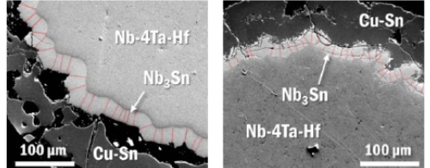
Industrial Relevance: Superconductor Manufacturing
Bronze method
Internal Tin (IT) Method
Powder-In-Tube (PIT) Method
[10] Barzi, E. & Zlobin, A., (2019).
Without annealing
With annealing at 1010 ºC/5h
[1] Banno, Nobuya, Scripta Materialia 199 (2021)
Notes:
Different manufacturing methods for niobium 3 tin wires
Niobium 3 tin has a lot of industry interest behind it
Kirkendall porosity, tin diffusing out of bronze along GB diffusion pathways, form SC phase

Slide 18
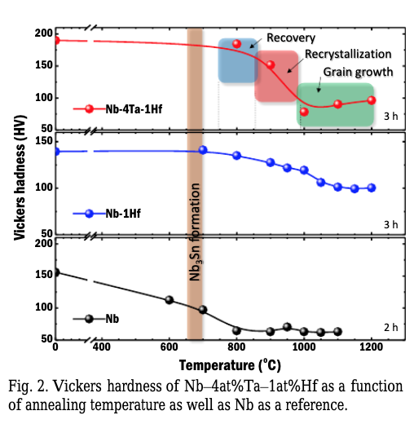
Effects of Hf on Recrystallization
Hf effects on Nb microstructure:
Solid solution strengthening (SSS) and pinning centers (PC) [oxides/carbides]
Stabilization of grain growth kinetics(dragging forces) during recrystallization (Rx)
Maintain heavily worked structures (i.e. Nb wires grain sizes)
Increased grain boundary (GB) diffusion paths in Nb-base alloy for Sn during Nb₃Sn reaction, finer morphology
Increased flux pinning -> increased superconductor performance!
Micro Hardness (Hv)
[1] Banno, Nobuya, Scripta Materialia 199 (2021)
Notes:
What does hf do, why do we care, what mechanisims does it use, how can it focus our efforts?

Slide 19
Alloy Manufacturing: Compositions
Alloy | Compositions | Manufactured | Compression Tested
Nb-Ti | 2 wt.% | X | X
Nb-Zr | 2 wt.% | X | X
Nb-Hf | 2 wt.% | X | X
Nb-V | 2 wt.% | X | X
Nb | 100 wt.% | X | X
Nb-Ta | 2 wt.% | X | X
Nb-Mo | 2 wt.% | X | X
Nb-W | 2 wt.% | X | X
Nb-Re | ~1 wt.%
Alloying element selection process
Good solubility
Similar strengthening effects
SSS, PC, higher T_{m}
Minimal loss of workability
Cost effective
Group IV
Pinning centers & SSS [2, 3, 6]
Refractory
SSS & Tm ↑[3, 6]
Compositions
Industry practices for Nb alloys in superconductor manufacturing [5, 10]

Slide 20
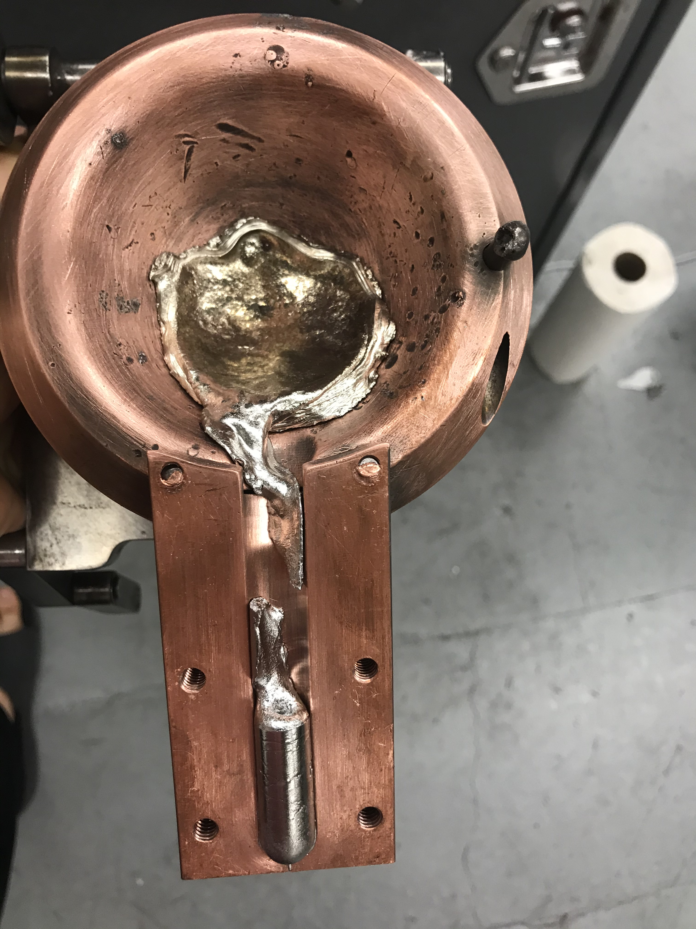
Alloy Manufacturing
Arc melting alloys
Cast as button
Round/bar ingot casts
EDM for more specific shapes
Compression cylinders/plates

Slide 21
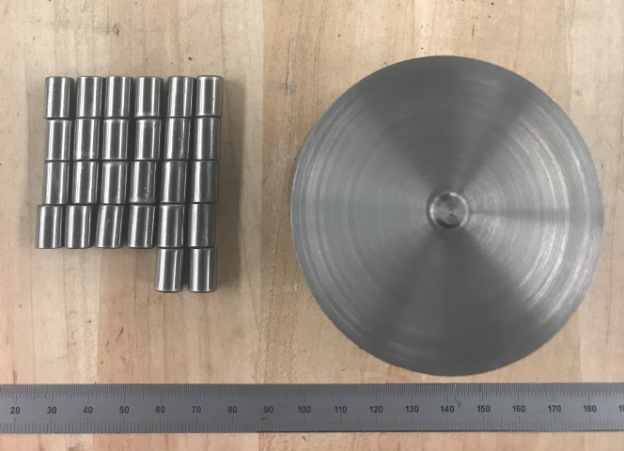
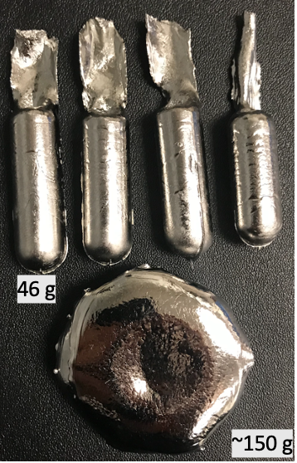
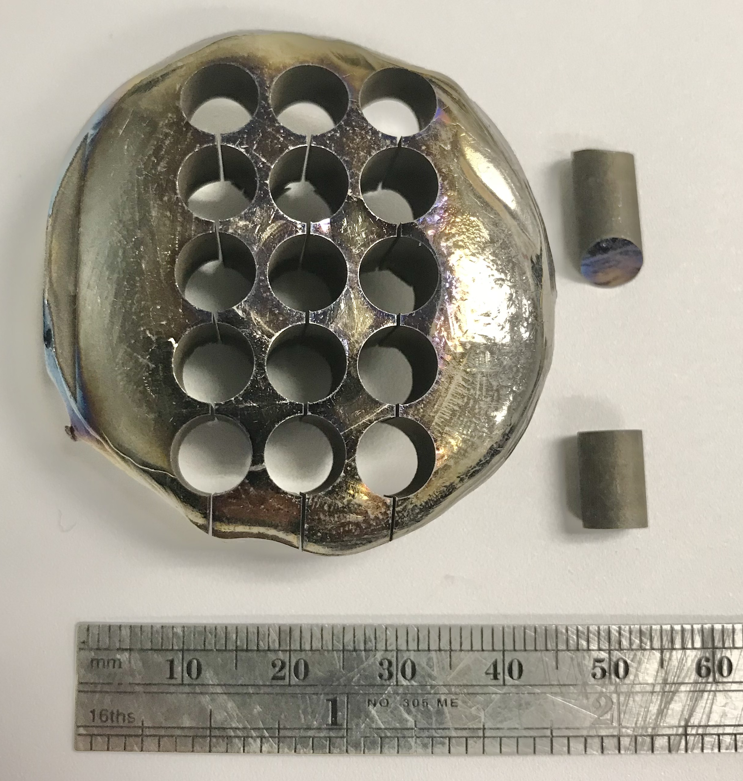
Alloy Manufacturing
C-103 → 8:12mm compression cylinders
Arc melting alloys
Cast as button
Round/bar ingot casts
EDM for more specific shapes
Compression cylinders/plates
2wt.% binaries→ 6:9 mm compression cylinders

Slide 22
Deformation Testing: Gleeble
Compression tests:
Workability and flow stress
Guidelines for rolling
Failure → disqualification or remanufacture
Room Temperature
Reduce O pickup
Strain rates:
1 , 10 s⁻¹
Reduction: 60%
All binaries and CP Nb tested

Slide 23
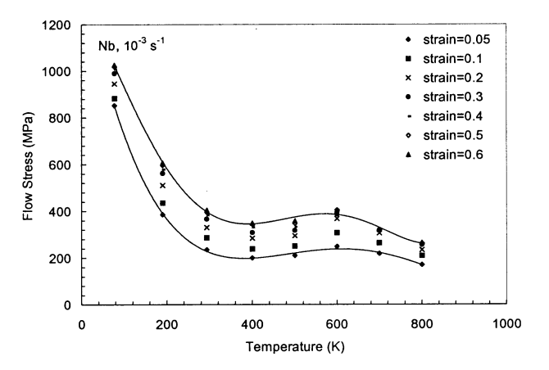
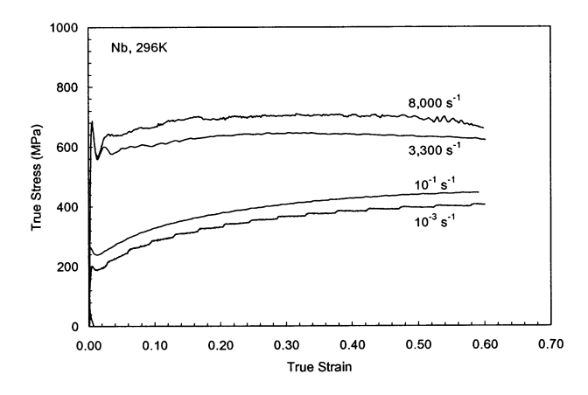
Deformation Testing: Literature Review
S. Nemat-Nasser, - MATER SCI ENG A-STRUCT MATER 2000
Literature values for the flow stress values of pure Nb over a range of temperatures and strain rates
Quasi-static 10⁻³ s⁻¹ to a true strain of 70%
Dynamic rates of 3300 and 8000 s⁻¹ to a true strain of 70%
Temperatures from 77 - 800 K
Notes:
We see here that both strain types can achieve 70% deformation in pure Nb, at temp range less than what we are testing
Also see that dynamic rates typically yield high values for true stress strain curves

Slide 24
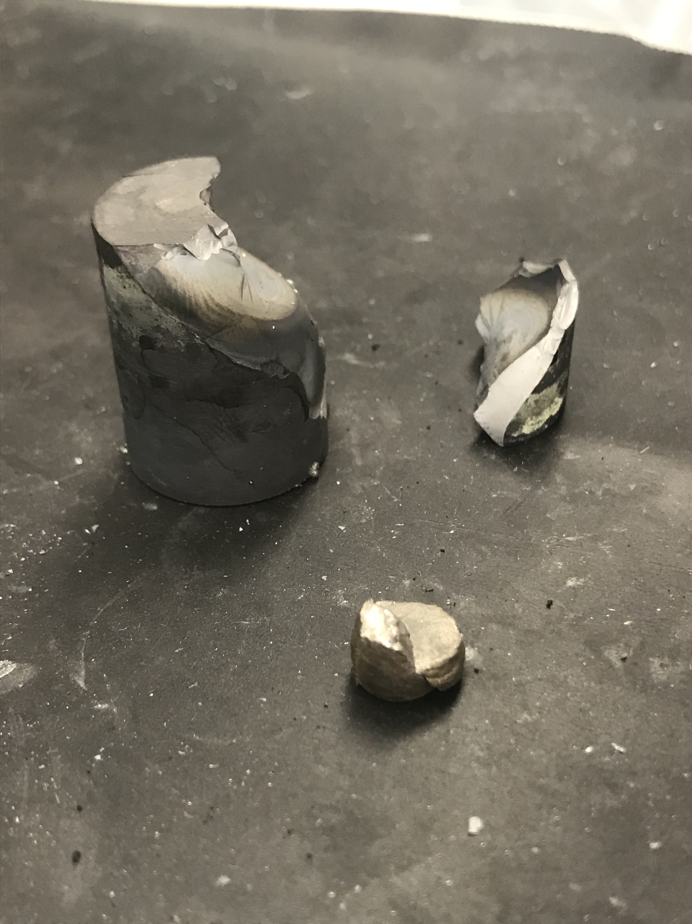
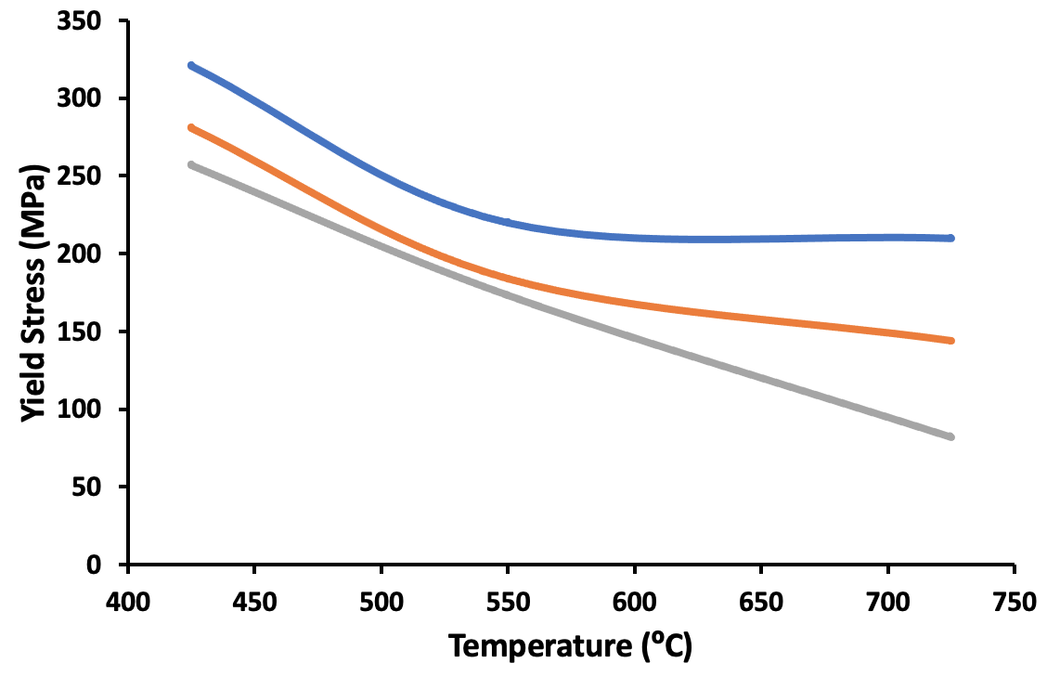
Mechanical Data at Room Temp
Have not processed data to make stress-strain curves
Good deformation (no cracking) →Nb, V, Hf, Ti, Mo
Unfavorable deformation (cracking) → Ta(1), W(1, 10), Zr(1,10)→
Zr alloy one of few binaries tested at for warm working conditions → work hardening response greater than Ti of Hf →
WC anvil cracking during one test
Alloy has unreasonably high O and N content
Ta alloy had unreasonably high O and N content, needs to be remade to increase processability
W alloy exhibits extremely brittle behavior with minimal to no workability. It’s interstitial content (C and N) are higher than acceptable
2wt.%Zr

Slide 25
Chemical analysis of binaries
Element (wt%) | CP Nb | Nb-2Mo | Nb-2W | Nb-2Ta | Nb-2V | Nb-2Zr | Nb-2Ti | Nb-2Hf
Al | 0.01 | 0.01 | 0.01 | - | - | - | - | -
C₁ | 0.01 | 0.01 | 0.02 | 0.01 | 0.01 | 0.01 | 0.01 | 0.01
Cu | <0.01 | <0.01 | <0.01 | <0.01 | 0.01 | 0.01 | <0.01 | 0.02
Fe | 0.02 | 0.02 | 0.03 | <0.01 | <0.01 | 0.02 | 0.02 | 0.03
Hf | <0.01 | <0.01 | <0.01 | <0.01 | <0.01 | <0.01 | <0.01 | 1.9
Mo | <0.01 | 2.02 | <0.01 | - | - | - | - | -
N₂ | <0.01 | <0.01 | 0.22 | 0.22 | 0.02 | 0.07 | <0.01 | <0.01
Na | <0.01 | <0.01 | <0.01 | - | - | - | - | -
Nb₃ | 99.89 | 97.86 | 98.17 | 97.51 | 97.89 | 97.73 | 97.62 | 97.75
O₂ | 0.01 | 0.02 | 0.1 | 0.11 | 0.06 | 0.06 | 0.07 | 0.07
Si | <0.05 | <0.05 | <0.05 | - | - | - | - | -
Ta | 0.05 | 0.05 | 0.05 | 2.07 | 0.06 | 0.05 | 0.06 | 0.08
Ti | 0.01 | 0.01 | 0.01 | <0.1 | <0.1 | <0.1 | 2.01 | <0.1
V | <0.01 | <0.01 | <0.01 | 0.05 | 1.93 | <0.01 | <0.01 | <0.01
W | <0.01 | <0.01 | 1.36 | 0.02 | 0.02 | 0.04 | 0.2 | 0.09
Zr | <0.01 | <0.01 | 0.01 | <0.01 | <0.01 | 2.01 | <0.01 | 0.05

Slide 26
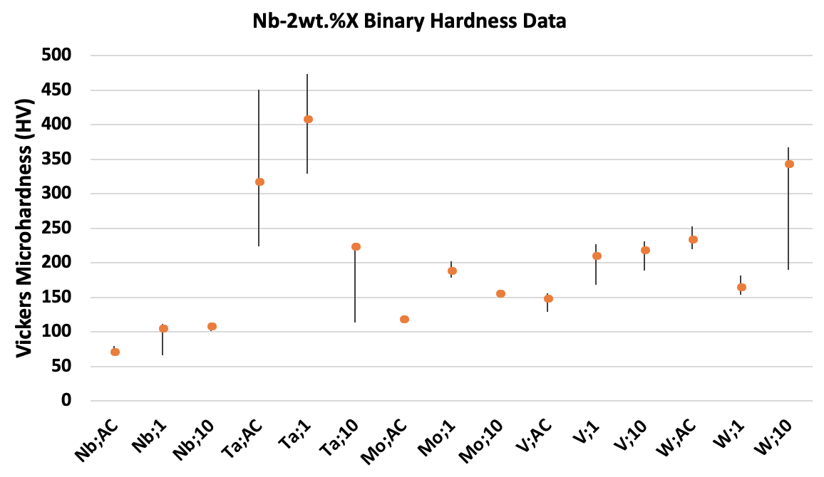
Hardness data for RT Compressed Binaries

Slide 27
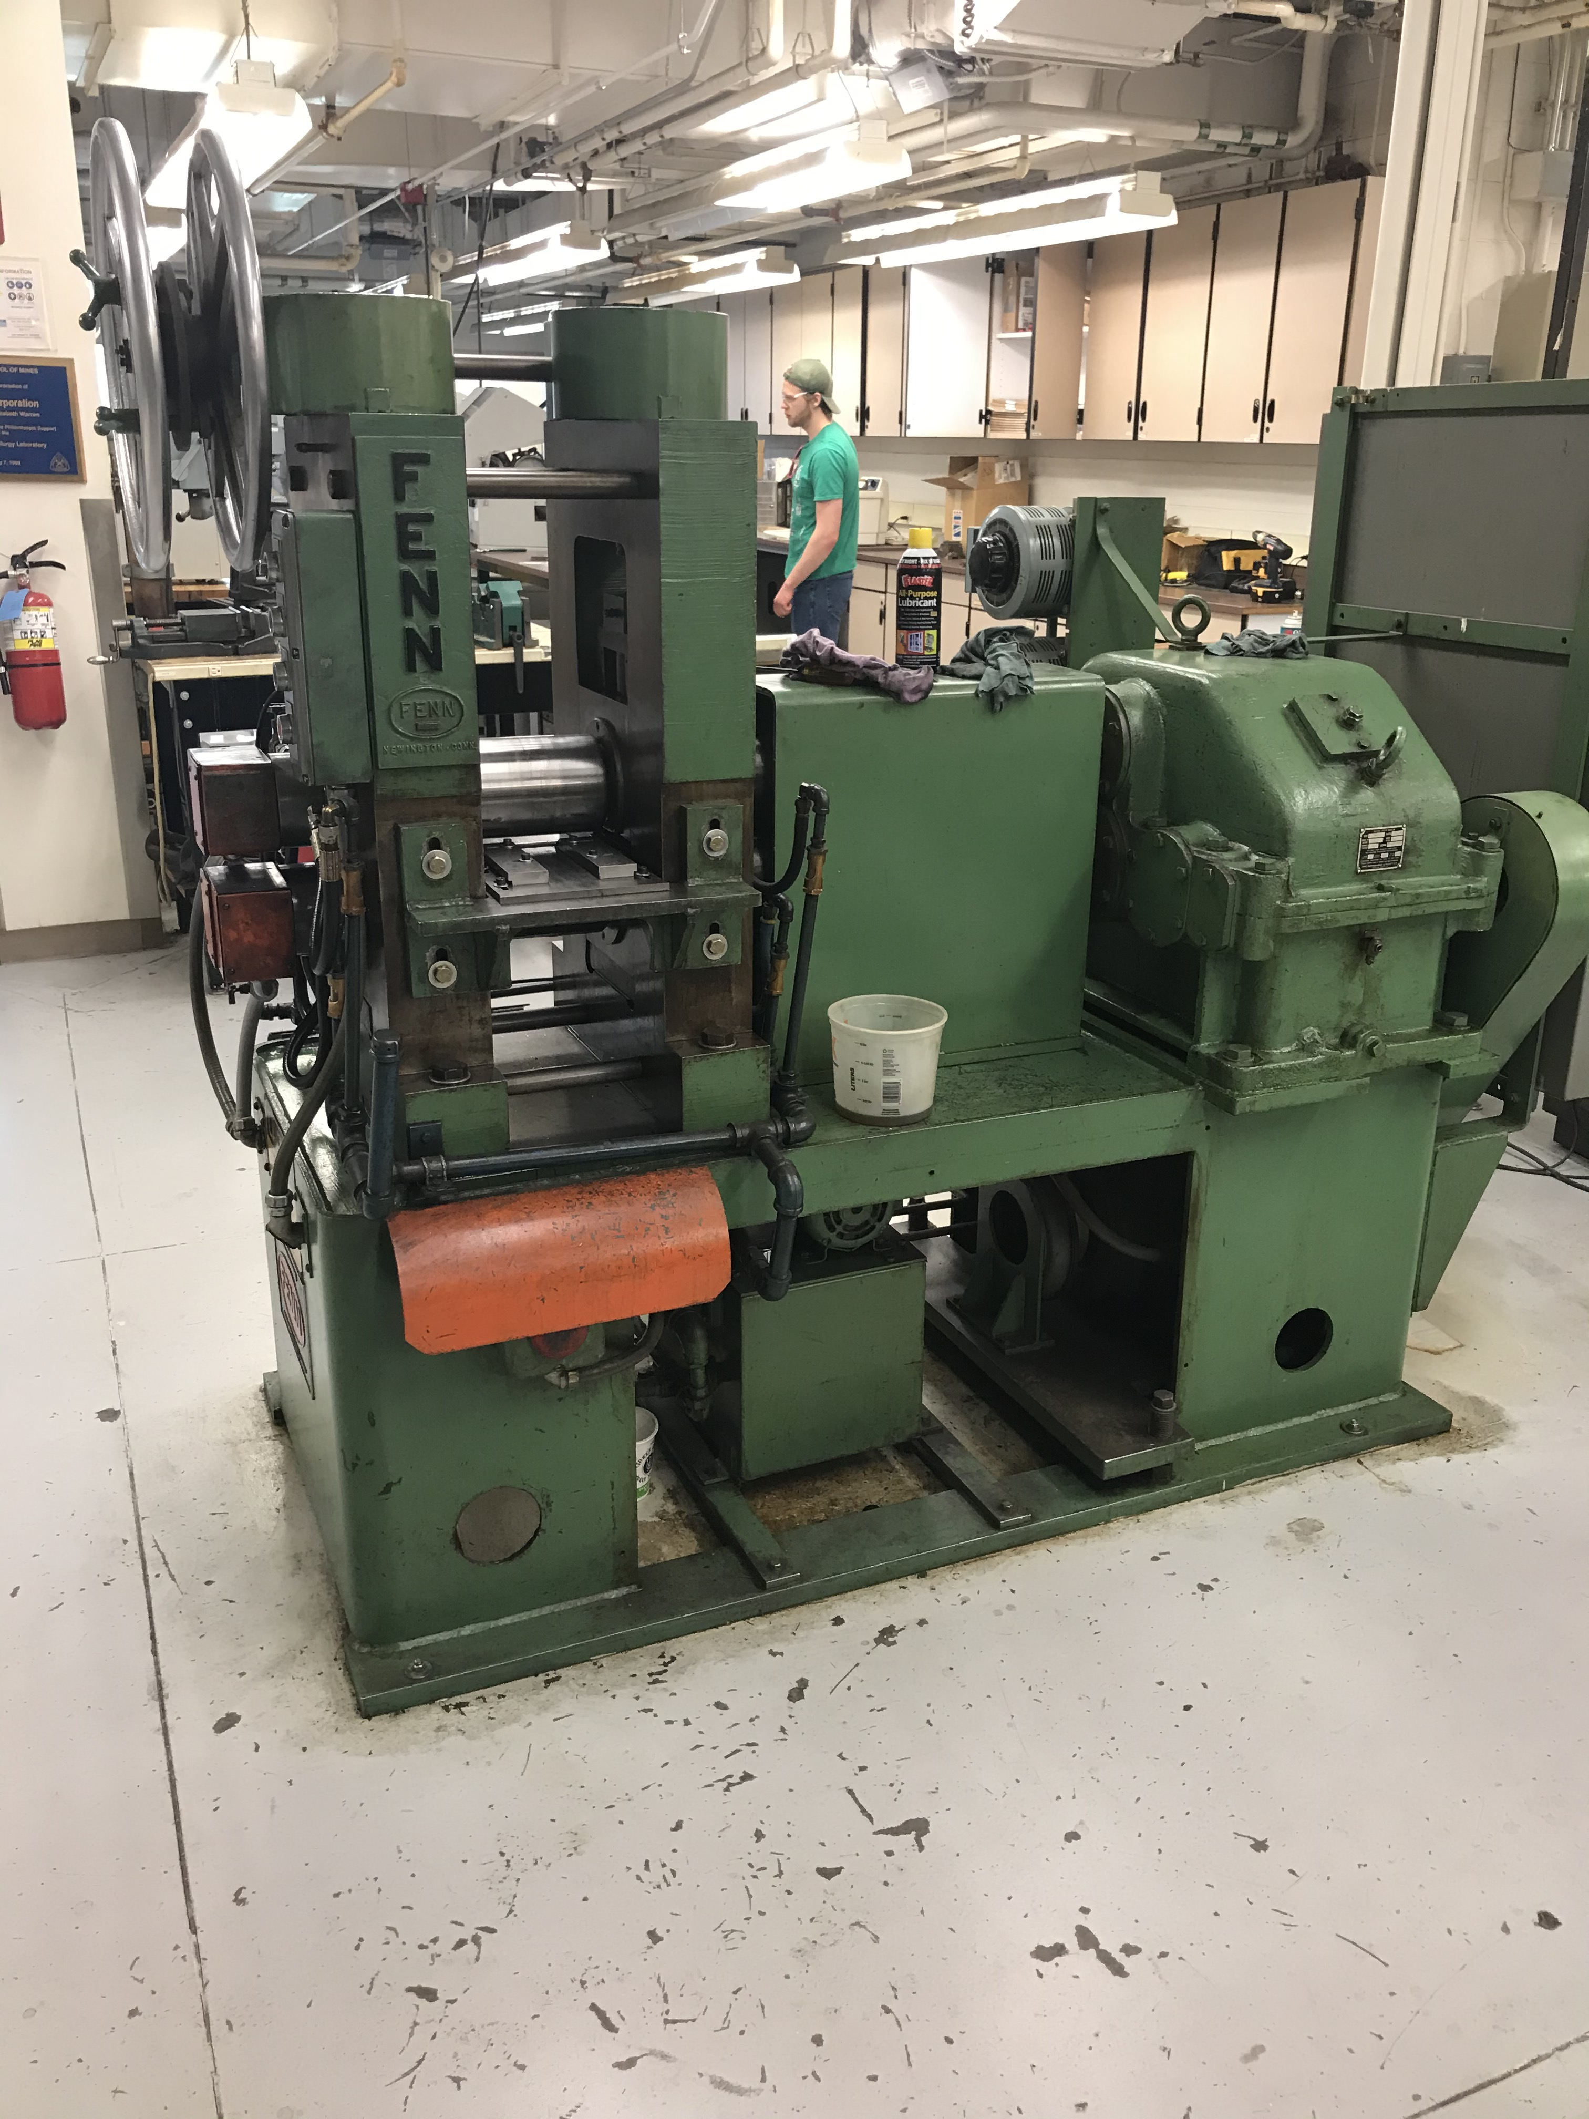
Deformation Testing: Rolling Mill
Samples will be reduced >60% via cold rolling
Roll mill capable of 1200 °C (1473 K) hot rolling
Reduction increments: ~5 - 12 %
Hardness measurements: to document work hardening behavior
Microstructure analysis: post rolling and post RX heat treatment
Document deformation energy and temperature which marks onset of RX

Slide 28
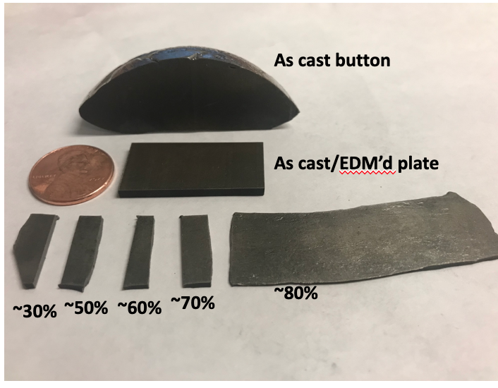
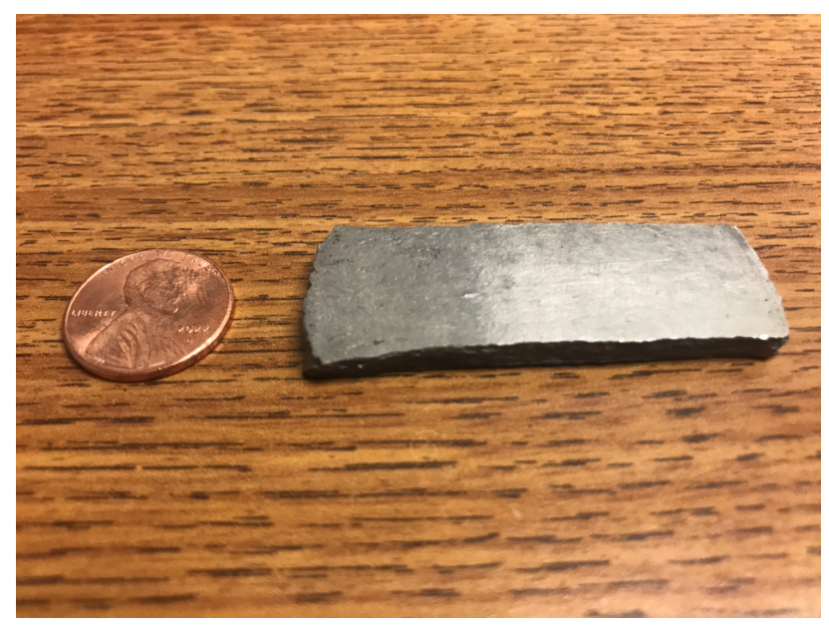
Rolling: plates & ingots
Rolled material
Tilt cast ingot: ~43 grams @ 60% redux
Difficult to cast
EDM of plates(x3 per button)
16x32x2.5 mm
Reduction of 60%: 1 mm
Reduction to 80%: 0.5 mm

Slide 29
GANTT Chart
Jun 23
Sep 23
Nov 23
Feb 24
Apr 24
Feb 23
Apr 23
Dec 23
Jan 23
May 23
Jul 23
Oct 23
Jan 24
Mar 24
Mar 23
Aug 23
Coursework
Qualifying exam
Alloy Manufacturing
Compression testing
Rolling & hardness tests
Writing C-103 paper
EM microstructure analysis
Further testing

Slide 30
Summary of current result takeaways
C-103
Mechanical data → yield strength has T and 𝜖˙ dependance, typical of BCC alloys
Wrought C-103 → Processing maps: regions in T and 𝜖˙ space most efficient at imparting E_{deform} towards microstructural change
Unreliable instability region prediction
Microstructural data → microstructural and texture evolution
real world validation for processing maps
Kolsky data → ↑ T @ shock loading condition → cross slip re-activated, ↑deformation energy stored

Slide 31
Summary of current result takeaways
Binaries
Nb, V, Ti, Hf, Mo alloys all exhibit favorable deformation at room temp
W, Zr, Ta alloys showed cracking
Interstitial content (C,N,O) unacceptably high → re-make alloys → further testing
Hardness of Ta and W varies the most
Cold rolling Nb plates/ingots possible in rolling mill

Slide 32
Ongoing analysis/work
Hardness tests
C-103, may shed more light on validity of processing map
Binaries, curious to see how much harder Zr in comparison to the rest
Remake W, Zr, and Ta alloys
Get microstructural data on CP Nb rolled material

Slide 33
Future Challenges & Opportunities
Write the C-103 paper
Complete hardness measurements
Pass Quals
Remake alloys → additional compression testing
Process rolled materials → microstructural analysis
Heat treating rolled CP Nb material → Temp. and deformation % to activate RX
Adjust rolling & heat treatment parameters based on CP Nb study→ manufacture 2x sets of binaries for analysis
Thank you!
Will Waliser
wwaliser@mines.edu

Slide 34
References
[1] Banno, Nobuya, et al. "Influence of parent Nb-alloy grain morphology on the layer formation of Nb3Sn and its flux pinning characteristics." Scripta Materialia 199 (2021): 113822.
[2] Siciliano, Fulvio & Monteiro, Waldemar & Padilha, Angelo. (1995). Comparative study of the recrystallization of pure niobium and a Nb-1 wt.% Zr alloy. 86. 713-718.
[3] Savitskii, 1970, Physical Metallurgy Of Refractory Metals and Alloys
[4] Prokoshkin, D.A., Vasil'eva, E.V. & Vergasova, L.L. Interdiffusion of niobium and some refractory metals. Met Sci Heat Treat 9, 199–201 (1967). https://doi.org/10.1007/BF00653142
[5]Frank, R. G. (1968). Recent advances in columbium alloys. Refractory Metal Alloys Metallurgy and Technology, 325–372. https://doi.org/10.1007/978-1-4684-9120-3_9
[6] Wilkinson, W. D. (1969). Chapter 8. In Properties of refractory metals, Gordon and Breach Science, pp. 304–307.
[7] A. Sengupta, S.K. Putatunda, L. Bartosiewicz, J. Hangas, P.J. Nalios, M. Peputapeck, F.E. Alberts, “Tensile behavior of a new single-crystal nickel-based superalloy (CSMX-4) at room and elevated temperatures”, Journal of Materials Engineering and Performance”, 1994, 3:73-81
[8] C103 niobium-hafnium alloy professional manufacturer: Western Alloys. C103 Niobium-Hafnium Alloy Professional Manufacturer: Western Alloys. (n.d.). Retrieved October 5, 2022, from https://tantalum-niobium.com/niobium/niobium-c-103-alloy.html
[9] Burns, Timothy & Mates, Steven & Rhorer, Richard & Whitenton, Eric & Basak, Debasis. (2007). Recent results from the NIST pulse-heated Kolsky bar. Proceedings of the SEM Annual Conference and Exposition on Experimental and Applied Mechanics 2007. 2.
[10] Barzi, E. & Zlobin, A.. (2019). Nb3Sn Wires and Cables for High-Field Accelerator Magnets. 10.1007/978-3-030-16118-7_2.
[11] Williams, M. (2015, February 2). Exploring the universe with nuclear power. Phys.org. Retrieved March 27, 2023,
[12] Nemat-Nasser, S. & Guo, W.G.. (2000). Flow stress of commercially pure niobium over a broad range of temperatures and strain rates. Materials Science and Engineering A-structural Materials Properties Microstructure and Processing - MATER SCI ENG A-STRUCT MATER. 284. 202-210. 10.1016/S0921-5093(00)00740-1.
[13] Mates, S., 2020. Kolsky bar facility. https://www.nist.gov/mml/materials-science-and-engineering-division/mechanical-performance-group/kolsky-bar-facility.
[14] R. K. Gupta, V. Anil Kumar, T.V.S.V.S.N.M., 2021). Microstructure evolution during hot working of nb-10hf-1ti refractory alloy. Transactions of the Indian National Academy of Engineering 6, 111–121
[15] Fuyu Dong, Ye Yuan, W.L.Y.Z.P.K.L.X.Y.H.H., 2020). Hot deformation behavior and processing maps of an equiatomic monbhfzrti refractory high entropy alloy. Intermetallics 126, 106921

