Slide 1
Project 65: Quenching and Partitioning of Ti-6Al-4V and Novel Heat Treatments of β-Ti Alloys to Design Microstructures and Properties
Semi-annual Fall Meeting
September 2023
Student: Valava Sambandam Rani (Mines)
Faculty: Dr. Amy Clarke (Mines)
Industrial Mentors: ATI, Benjamin Ellyson (LLNL)

Slide 2
Project 65: Quenching and Partitioning of Ti-6Al-4V and Novel Heat Treatments of β-Ti Alloys to Design Microstructures and Properties
Student: Valava Sambandam Rani (Mines)
Advisor(s): Amy Clarke (Mines)
Project Duration
PhD: August 2021 to August 2025
Problem: To enhance the mechanical properties of Ti-6Al-4V and novel β-Ti alloys through heat treatments.
Objective: Develop an in-depth understanding about the effect of heat treatments on the microstructures and mechanical properties of Ti-6Al-4V and novel β-Ti alloys, including with additive manufacturing and heat treatments.
Benefit: Novel heat treatments will be designed to tailor microstructures in Ti-6Al-4V and novel β-Ti alloys which in turn would result in improved mechanical properties.
Recent Progress
Performed inter-critical annealing (i.e. near-transus) heat treatments based on the evolved heat treatment matrix
Conducted mechanical and microstructural characterization on the inter-critically annealed Ti-6Al-4V samples to understand the structure-property relationship in the as-quenched samples
Performed heat treatments and subsequent microstructural characterization to determine the partitioning parameters
Metrics
Description | % Complete | Status
1. Literature review and design of heat treatments | 50% | ●
2. Perform heat treatments | 20% | ●
3. Microstructural characterization (HT microstructural evolution) | 25% | ●
4. Tensile and compression testing (Strain-hardening and elongation behavior) | 25% | ●
5. Understanding the microstructure-mechanical properties relationship | 20% | ●

Slide 3
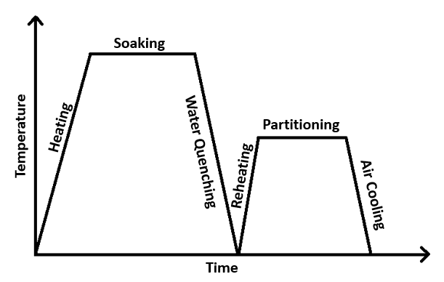
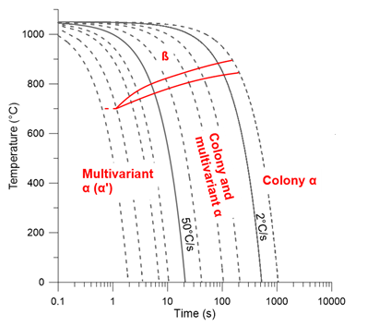
Quenching & Partitioning of Ti-6Al-4V
Ti-6Al-4V
α + β phases, equilibrium β ~10%
Ms Temperature ~575°C; β-Transus ~1000°C
Al stabilizes α; V stabilizes β
Quenching and Partitioning
Inter-critical anneal + water quench results in α + α’ composite
Aging + air cooling causes decomposition of α’
Improves work hardening behavior and strength-ductility balance
B. McArthur MS Thesis

Slide 4
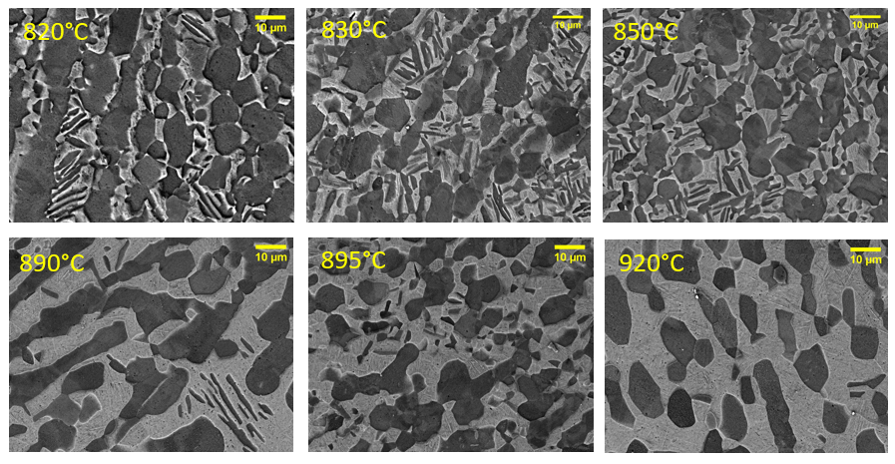
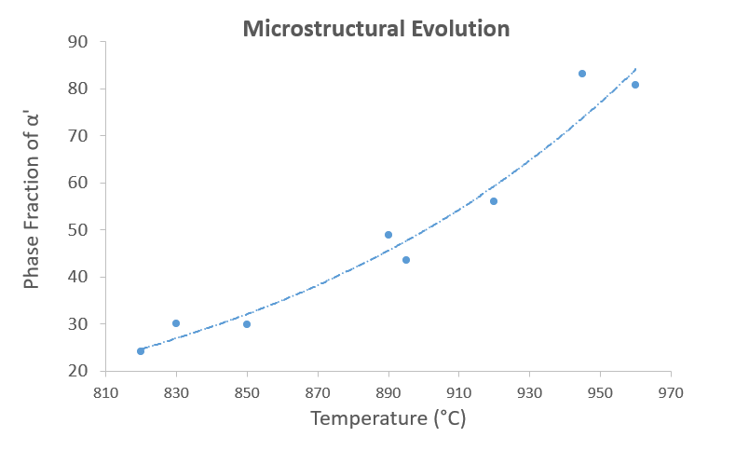
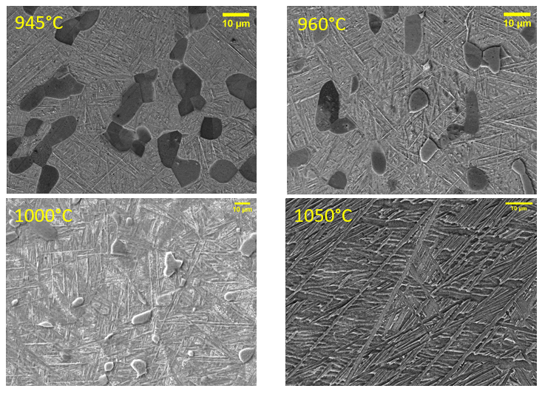
Previous Work – Dilatometry
Phase Fraction of α’ (%) | Inter-critical Annealing Temperature (°C)
 | Literature Survey | Thermocalc Simulations | Dilatometry Experiments
25 | 850 | 866 | 826
50 | 920 | 933 | 905
75 | 945 | 966 | 952
100 | 1000 | 989 | >1050

Slide 5
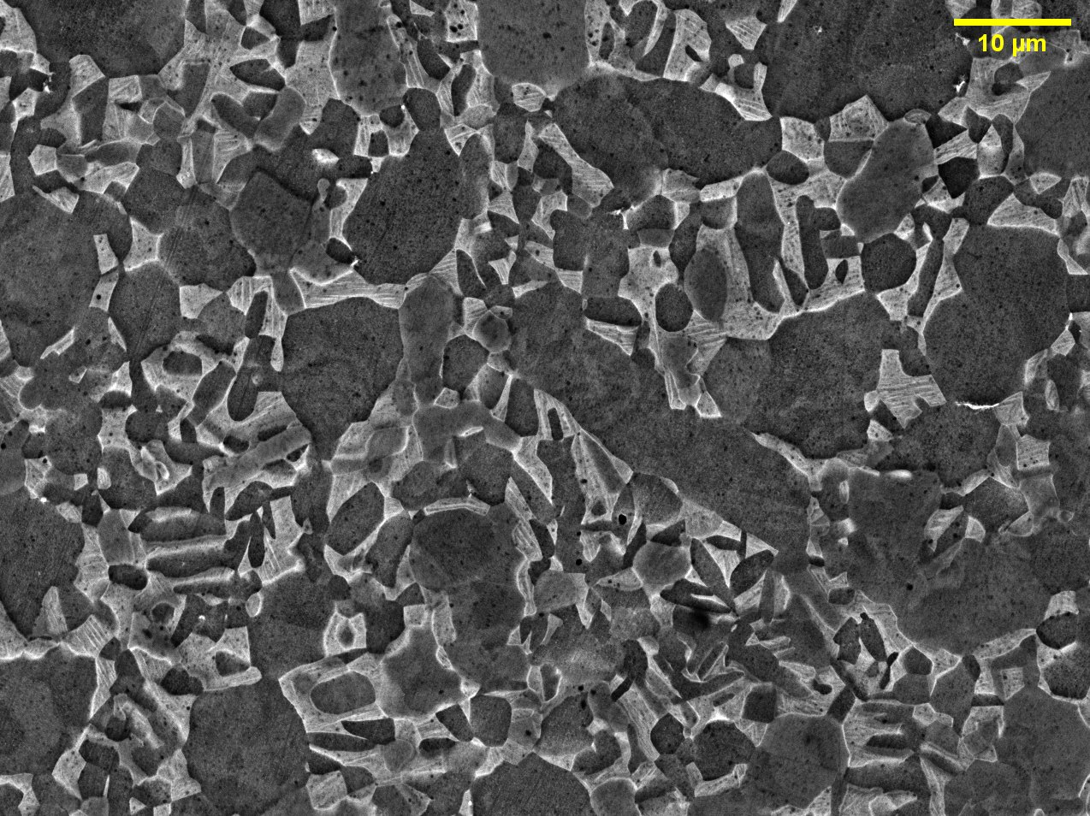
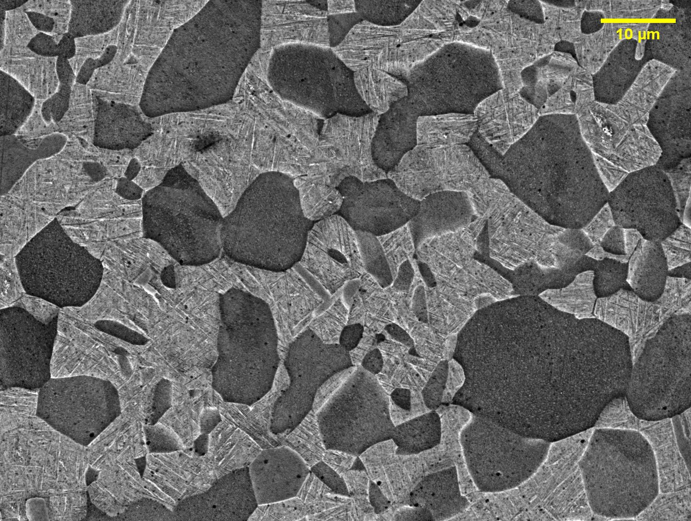
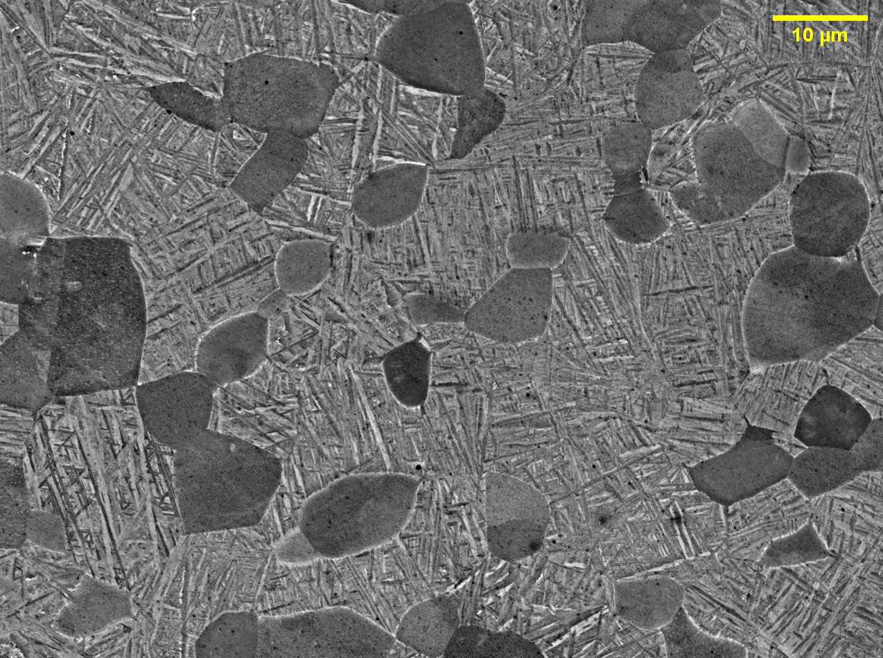
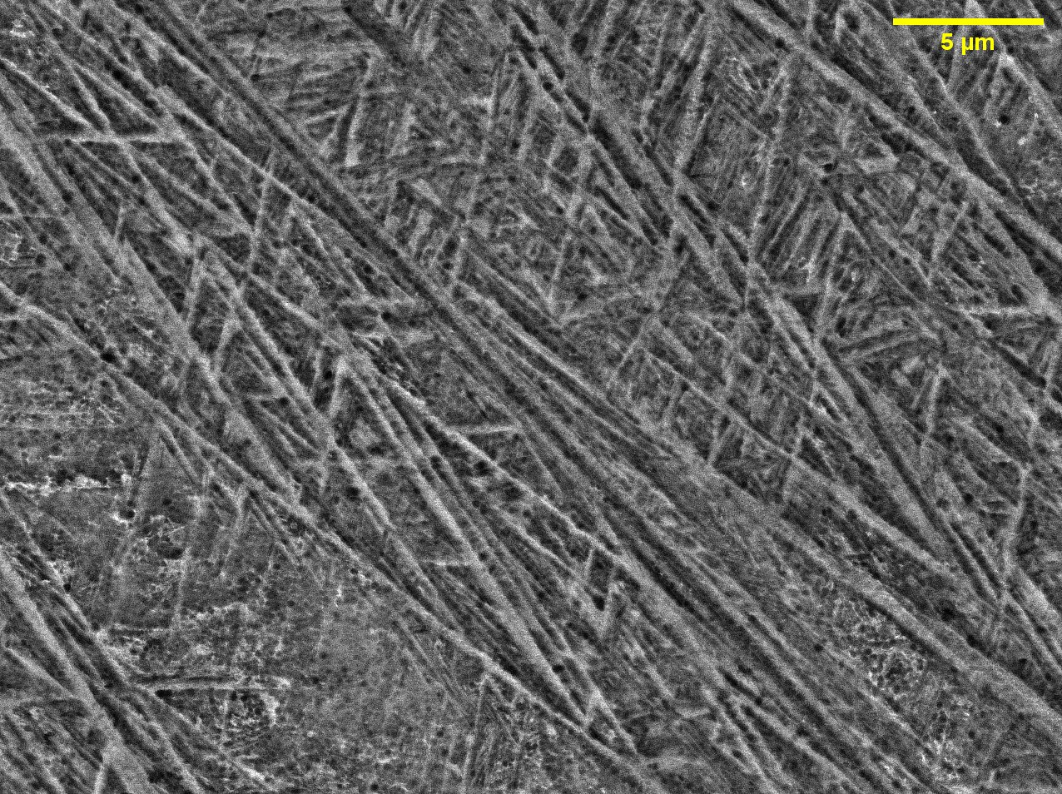
Previous Work – Inter-critical Annealing
Variation of α’ after 952°C unexpected
Inhomogenous furnace temperature and steep β-phase transformation curve
Exponential fitting of dilatometry data
Successful in varying α’ with heat treatment
Inter-critical Annealing Temperature (°C) | Expected Phase Fraction of α’ (%) | Obtained Phase Fraction of α’ (%)
826 | 25 | ~24
905 | 50 | ~49
952 | 75 | ~70
1100 | 100 | ~100
826°C
905°C
952°C
1100°C

Slide 6
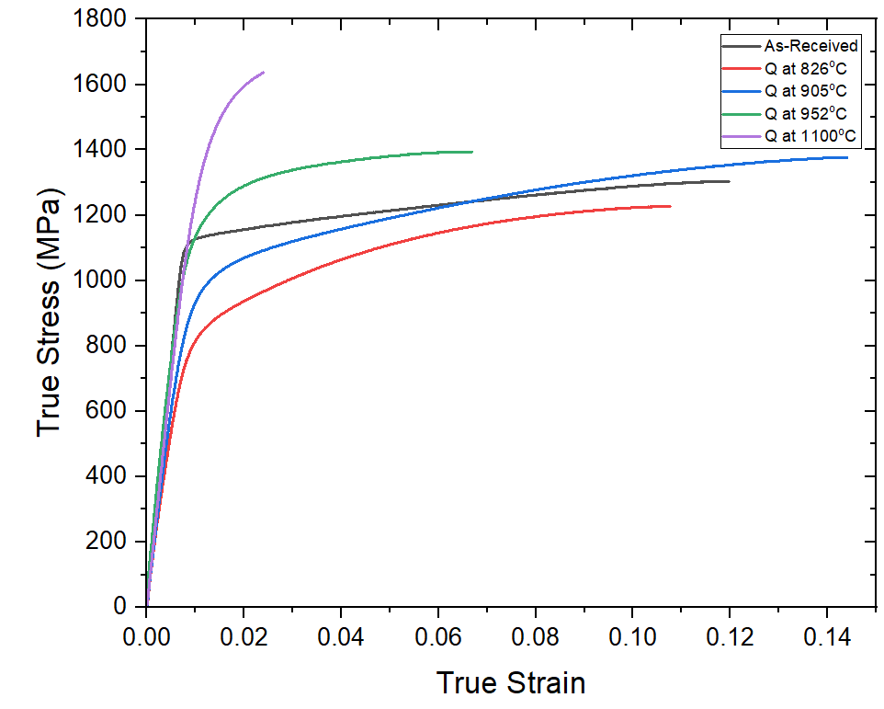
Tensile Testing
Strain rate = 0.0254 mm/s
Inter-critical Annealing Temperature (°C) | Expected Phase Fraction of α’ (%)
As-received | -
826 | 25
905 | 50
952 | 75
1100 | 100

Slide 7
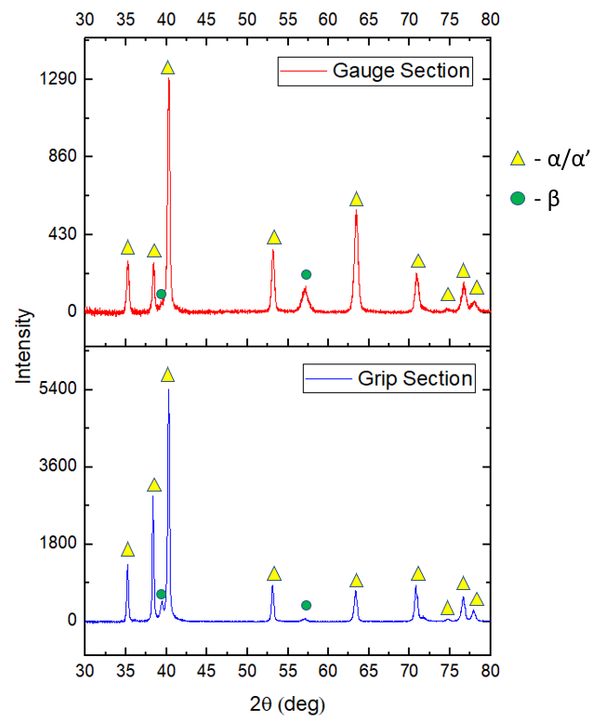
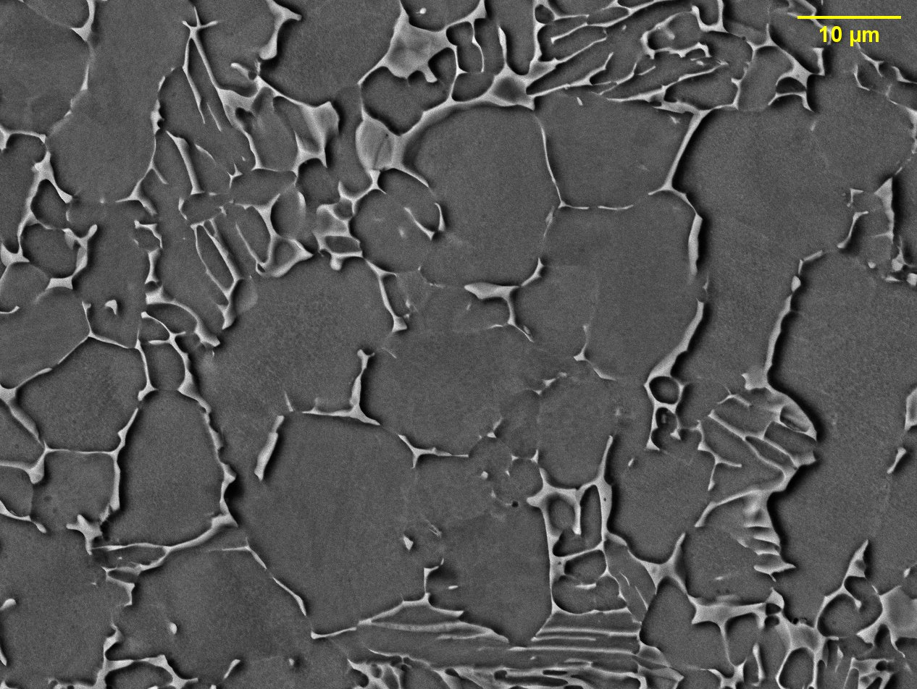
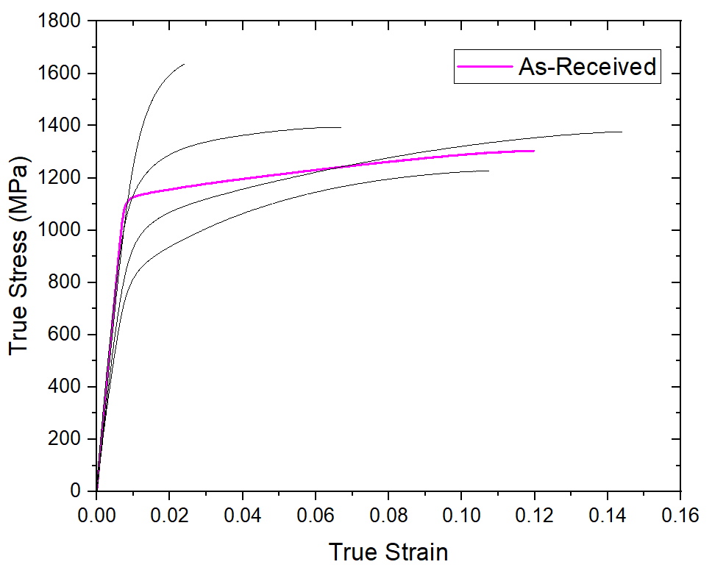
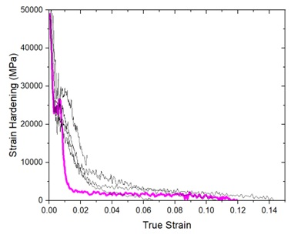
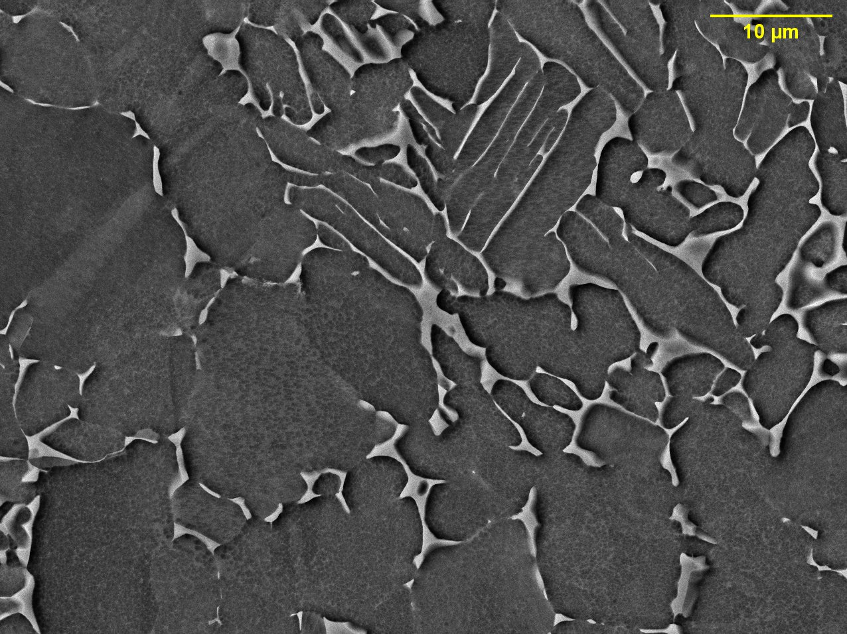
As-received Mill-Annealed Ti-6Al-4V
β phase fraction = 10.94%
Gauge Section
(200)
(110)
Grip Section
(200)
(110)

Slide 8
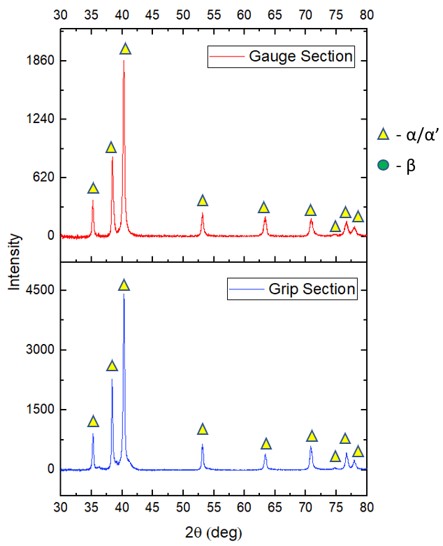
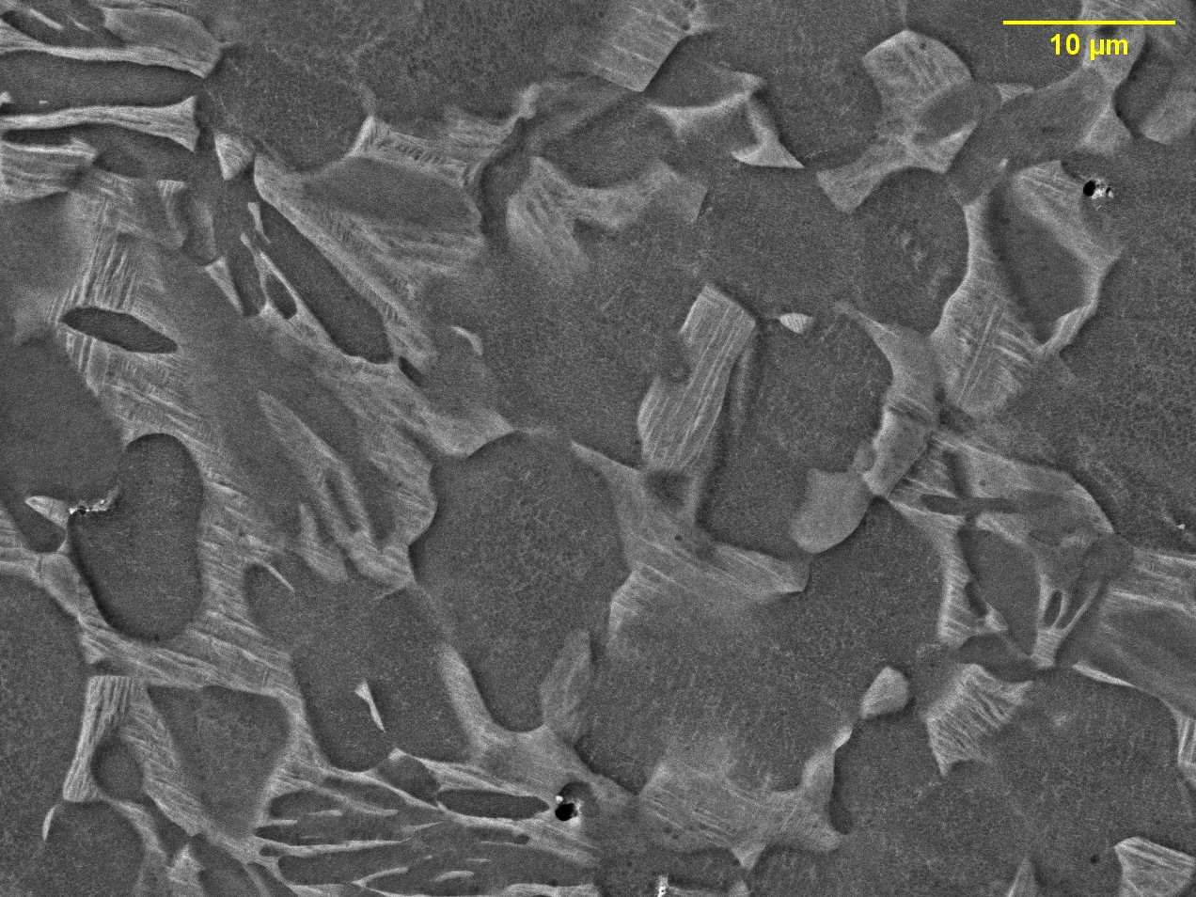
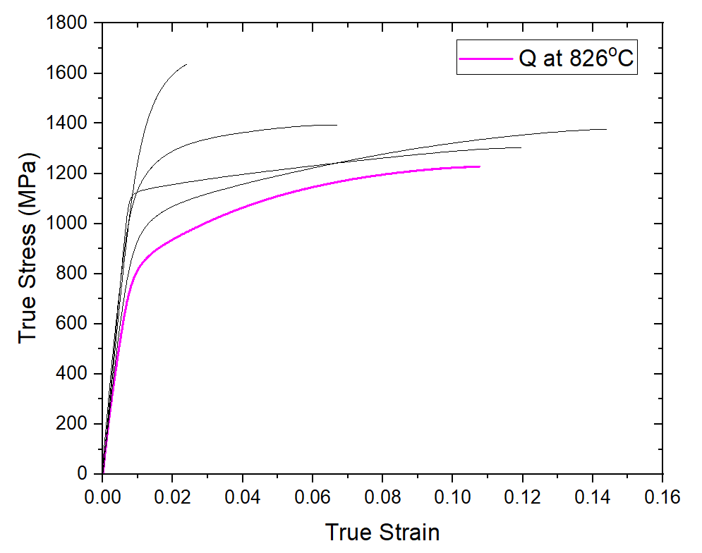
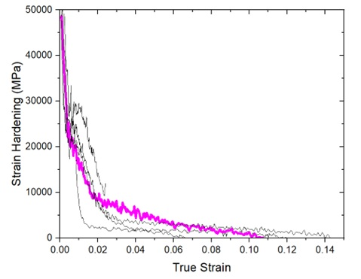
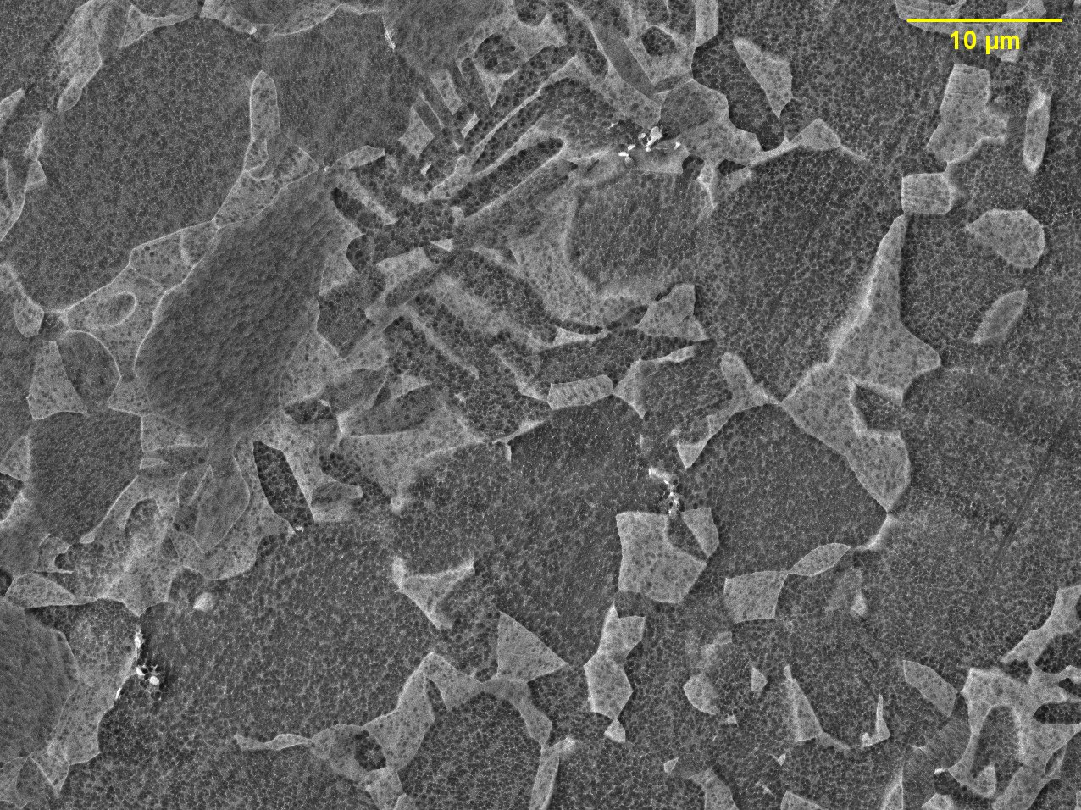
Inter-critical Annealing at 826°C for 2h + WQ
α’ phase fraction ~25%
Gauge Section
Grip Section

Slide 9
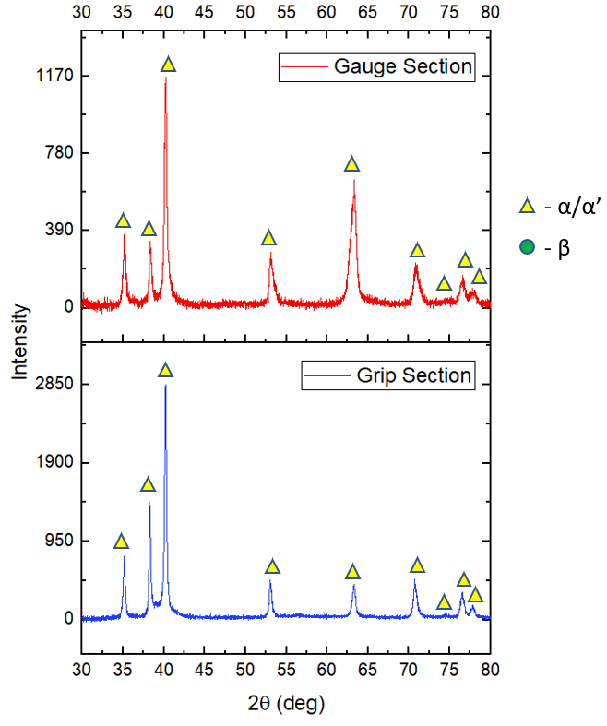
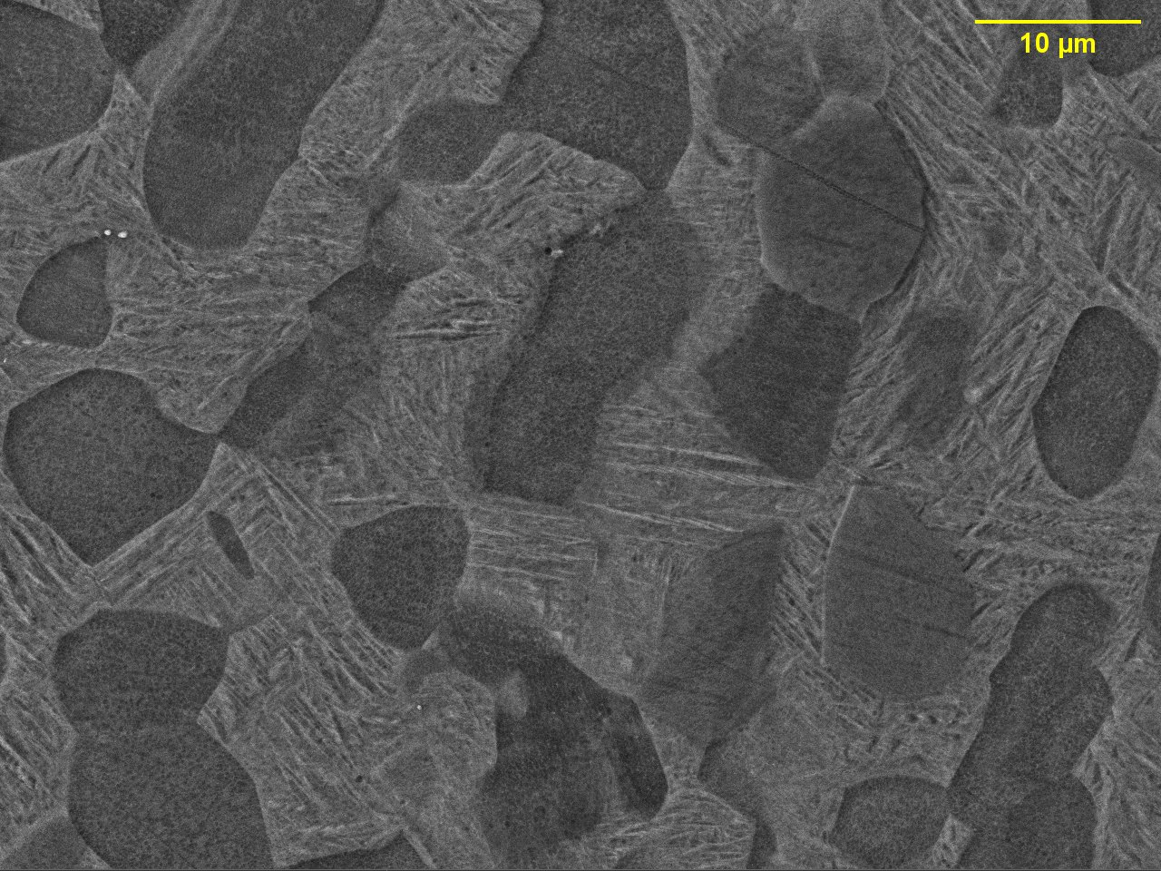
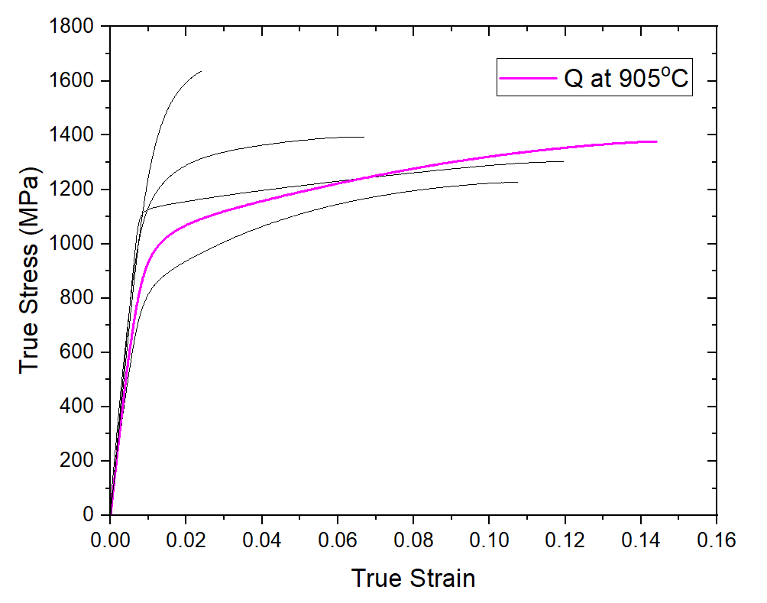
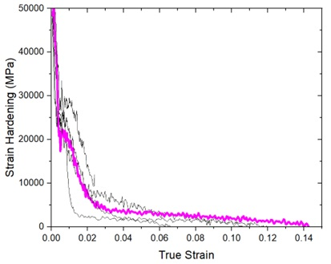
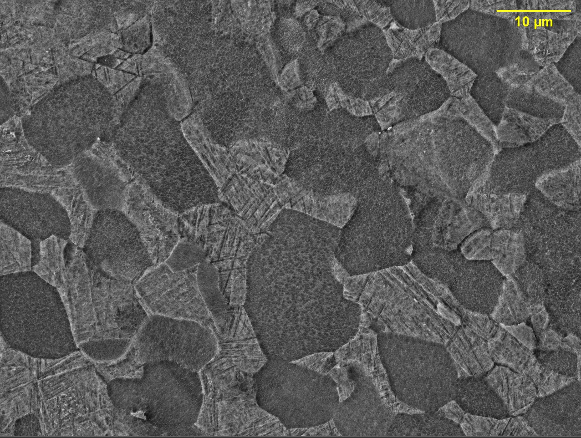
Inter-critical Annealing at 905°C for 2h + WQ
α’ phase fraction ~50%
Gauge Section
Grip Section

Slide 10
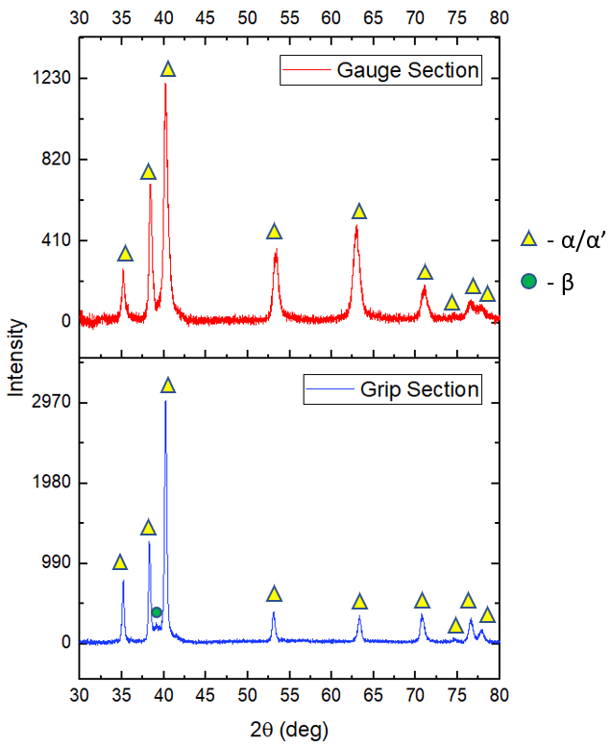
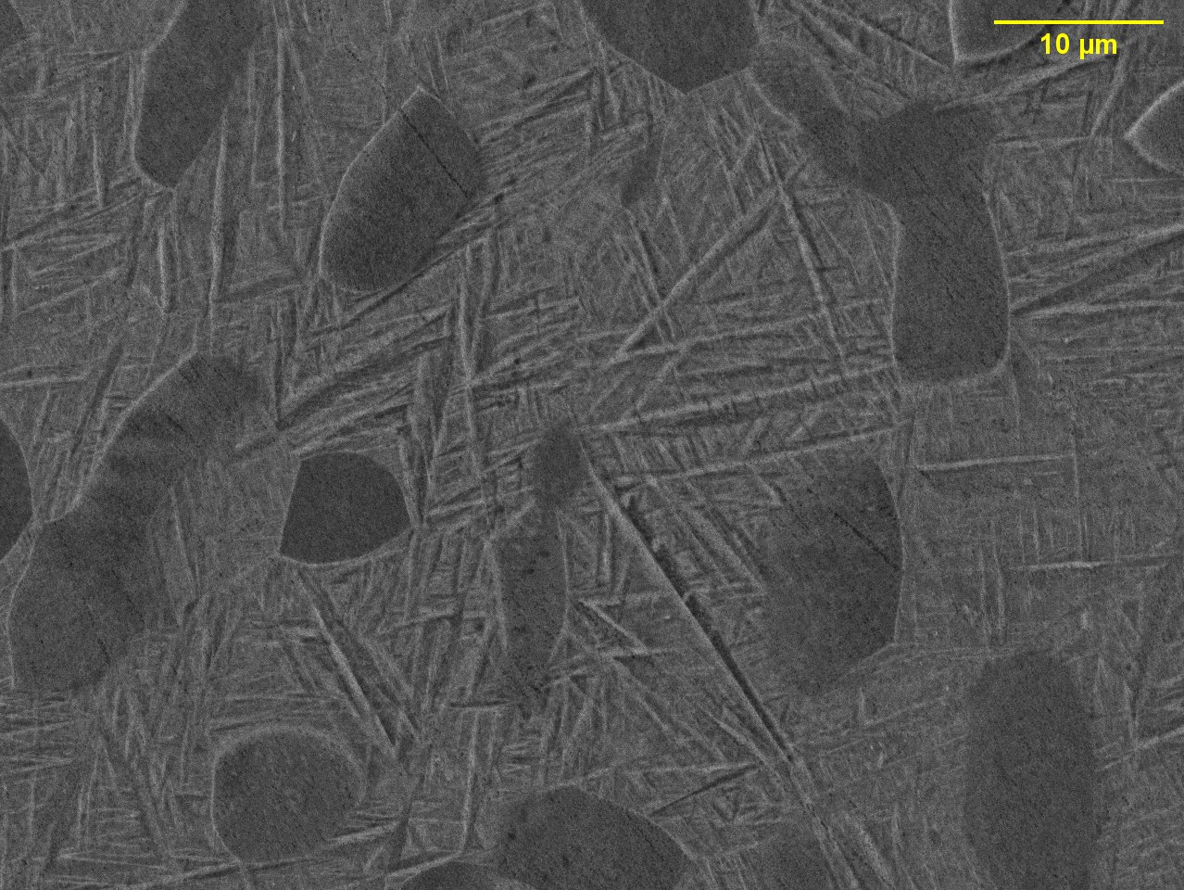
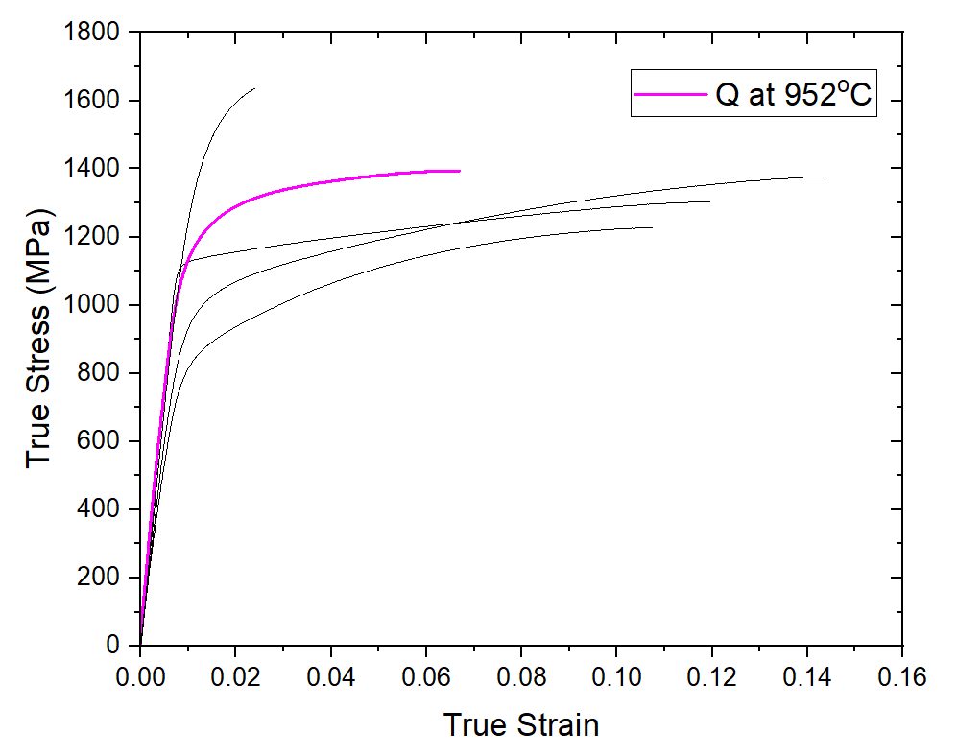
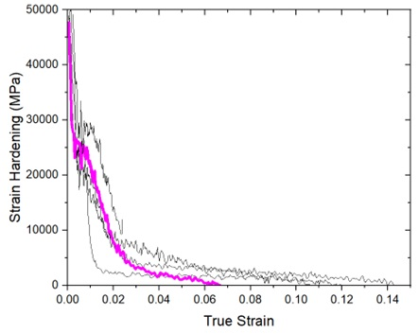
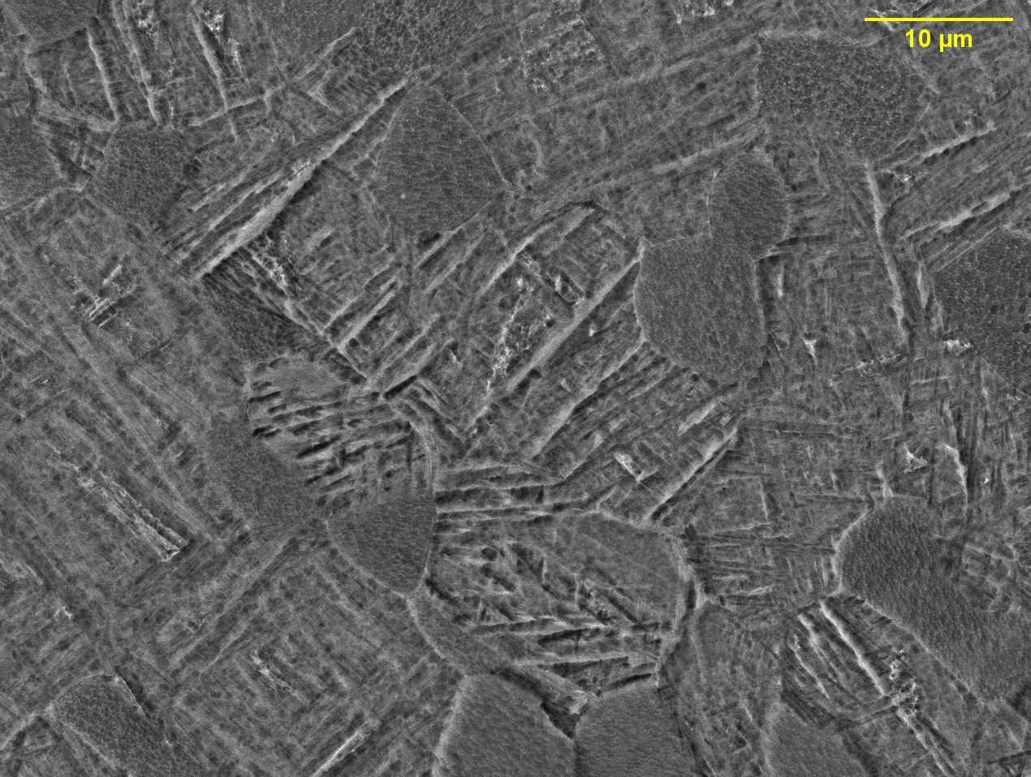
Inter-critical Annealing at 952°C for 2h + WQ
α’ phase fraction ~75%
Gauge Section
Grip Section
(110)

Slide 11
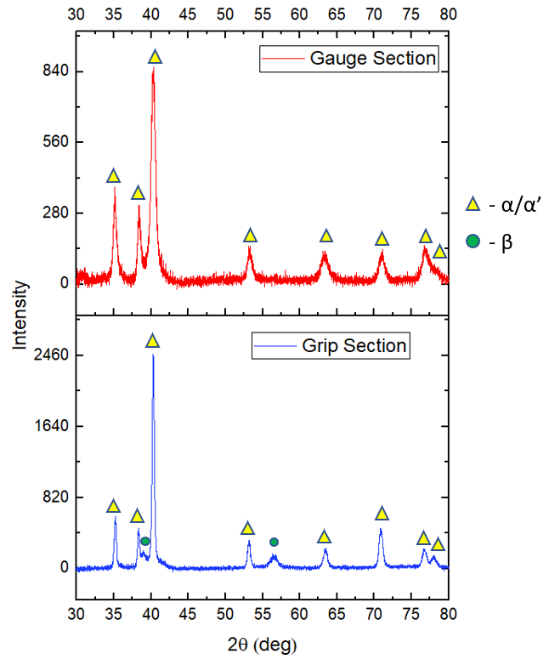
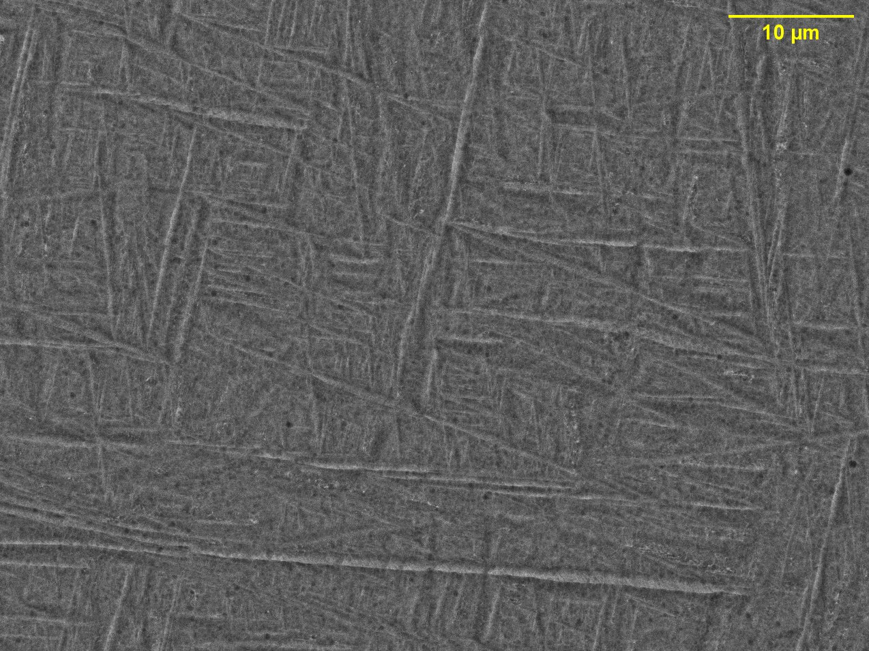
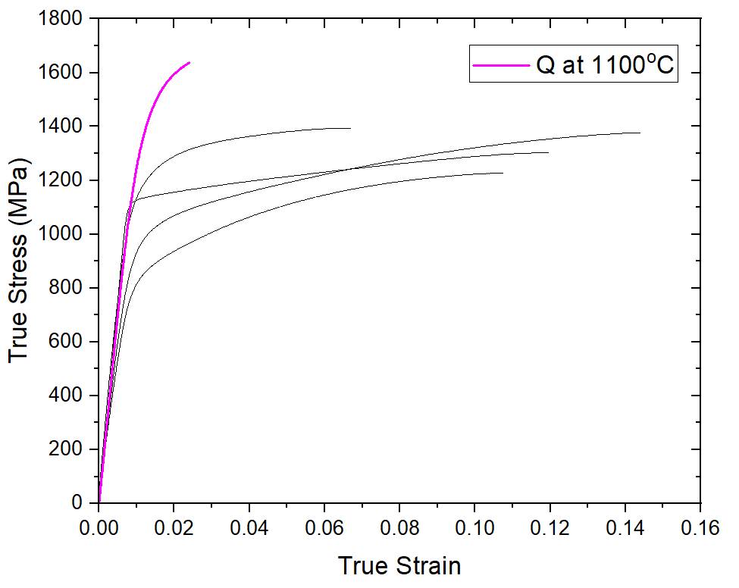
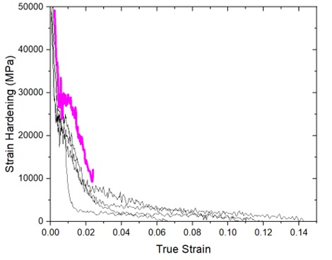
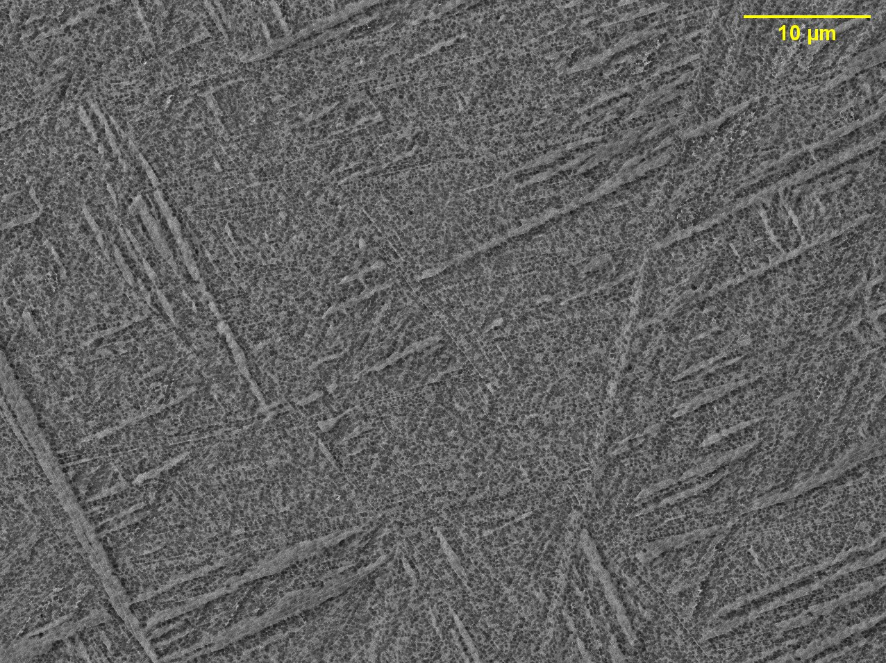
Inter-critical Annealing at 1100°C for 2h + WQ
α’ phase fraction = 100%
Gauge Section
Grip Section
(200)
(110)

Slide 12
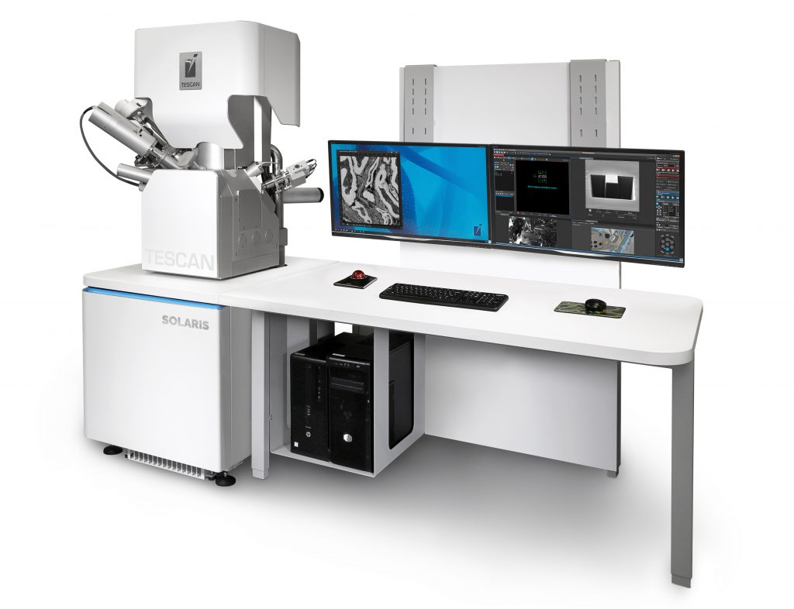
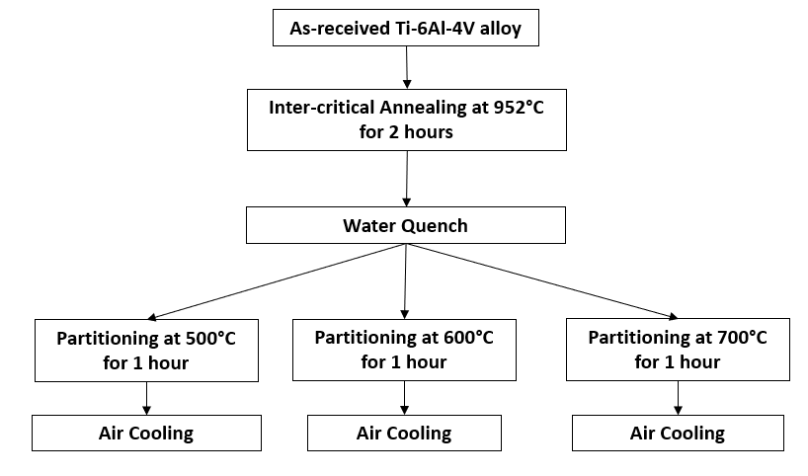
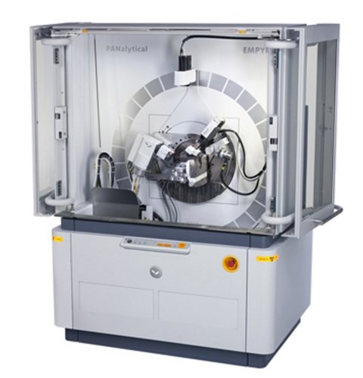
Partitioning Heat Treatment
TESCAN S8252G RAMAN-SEM/FIB
PANanalytical Empyrean X-ray Diffractometer

Slide 13
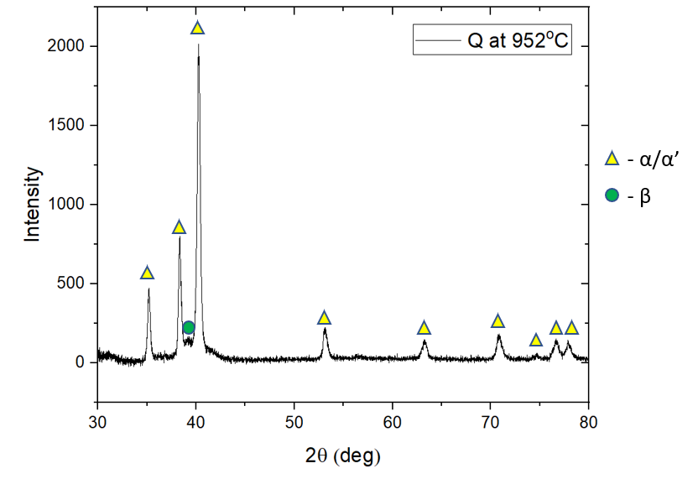
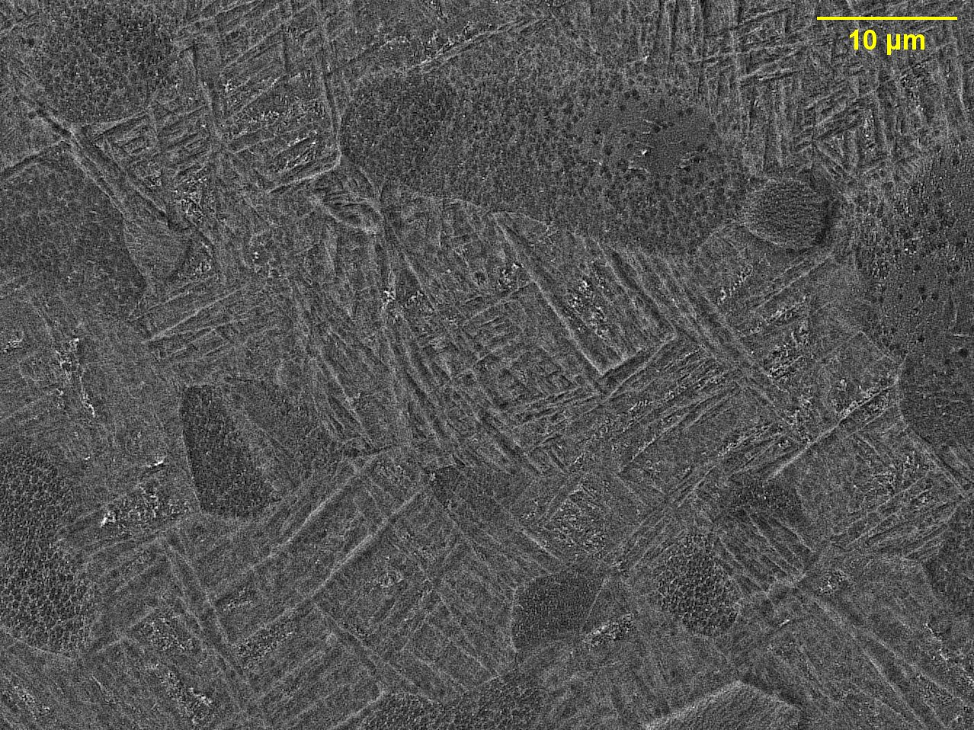
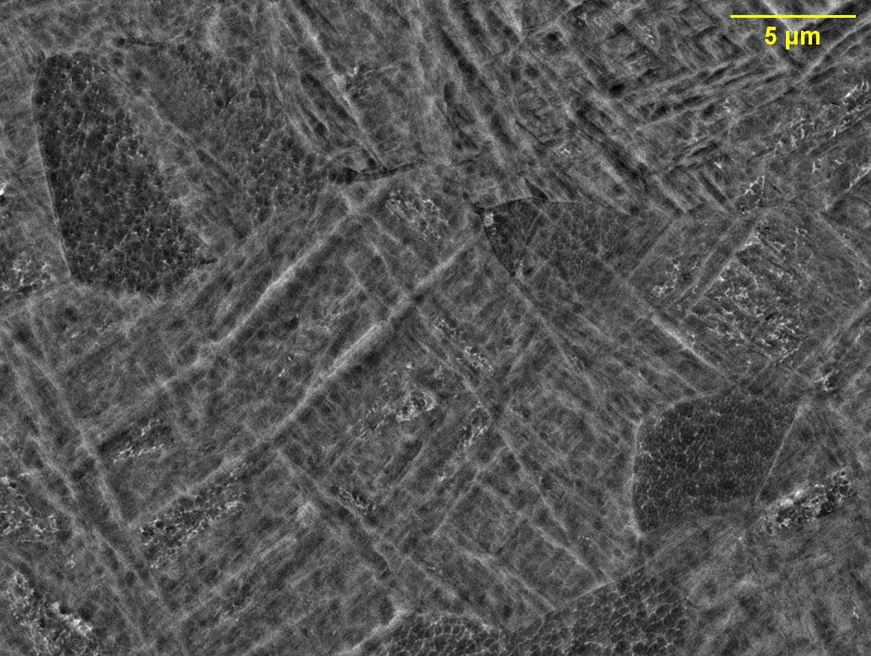
Quenching at 952°C
α’ phase fraction ~75%
XRD peak of β-phase was detected
(110)

Slide 14
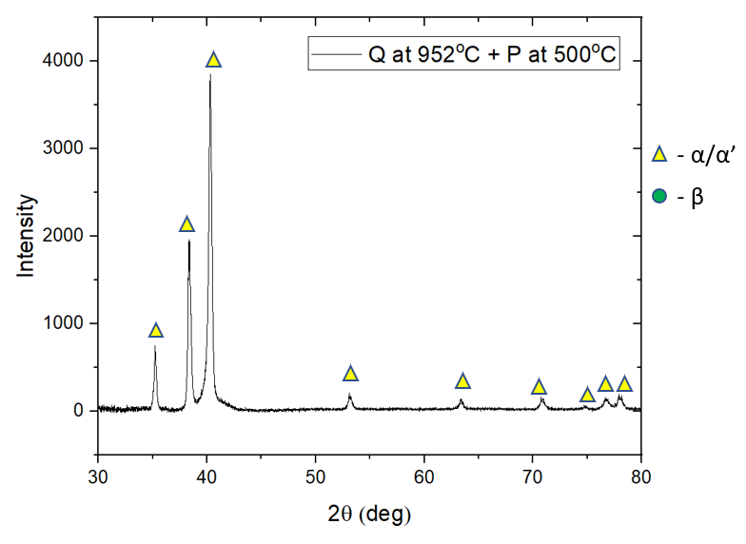
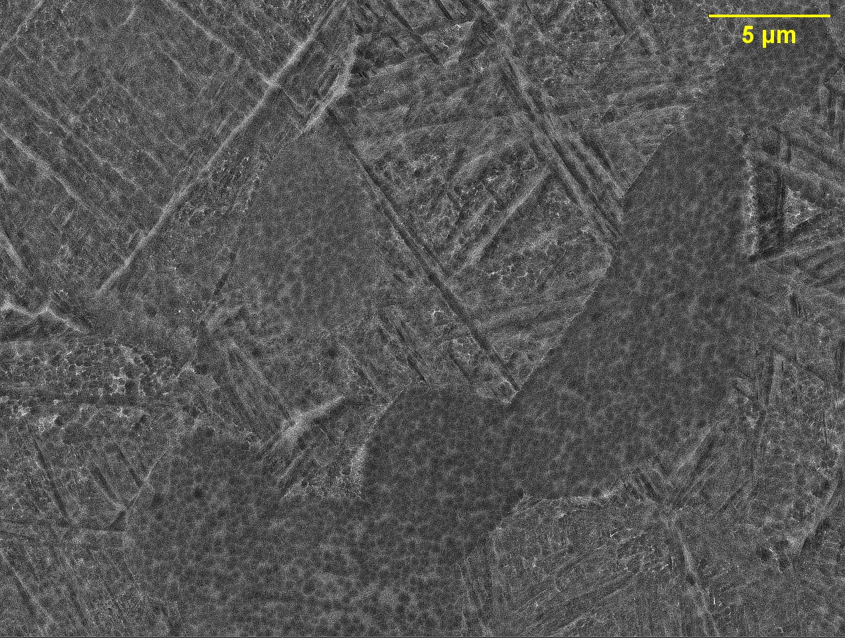
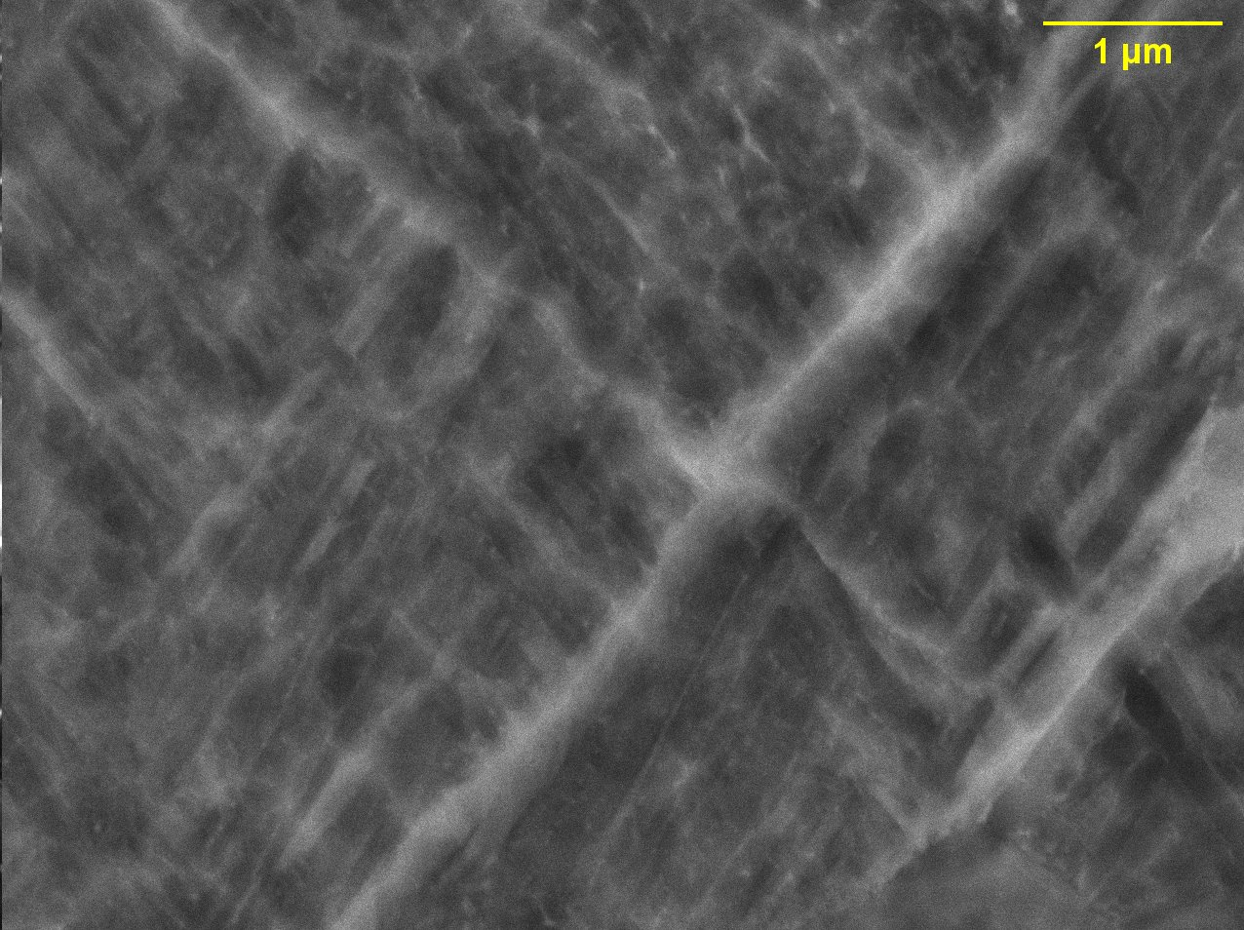
Quenching at 952°C + Partitioning at 500°C
No change in the microstructure
α’ phase still intact
XRD peak of β-phase not detected

Slide 15
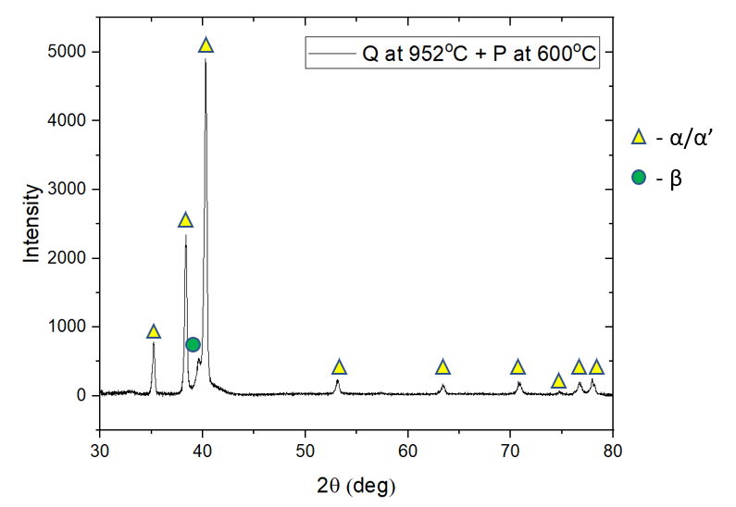
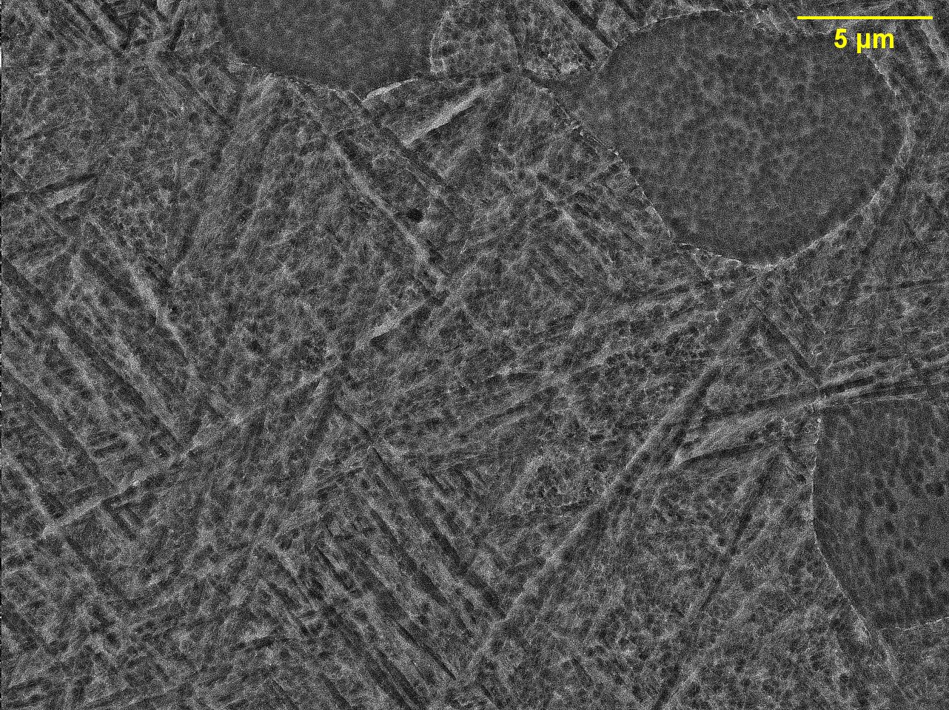
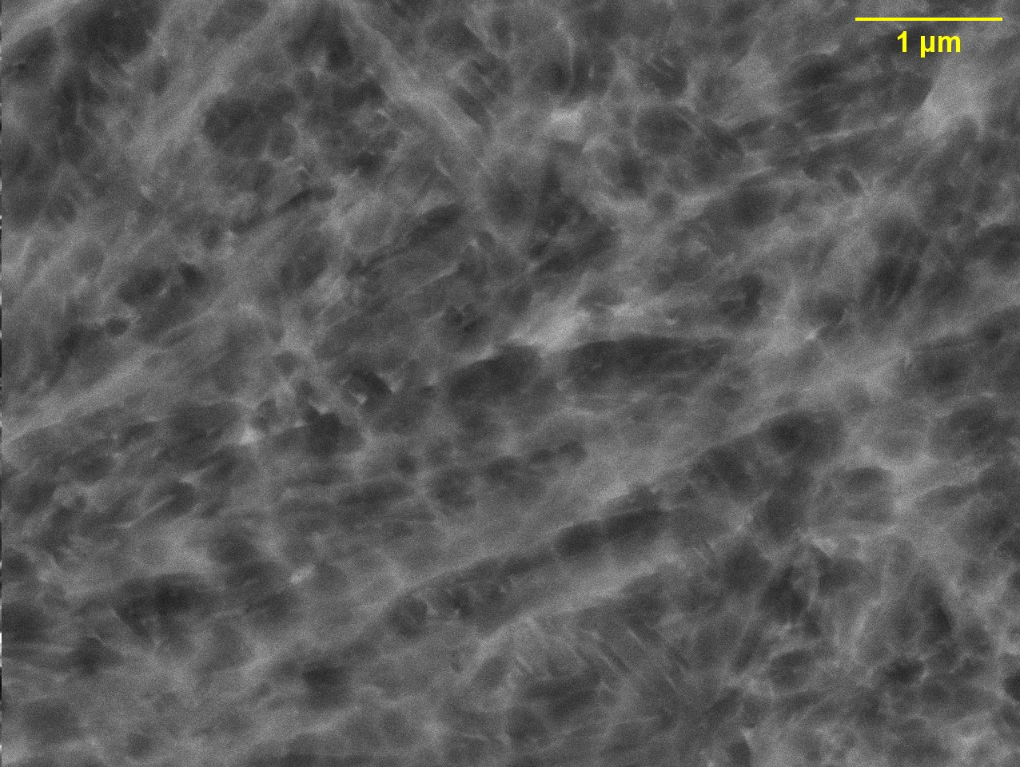
Quenching at 952°C + Partitioning at 600°C
Start of α’-phase decomposition
Sub-micron scale globules of β-phase
XRD peak of β-phase evident
Partial decomposition of α’ into α+β
(110)

Slide 16
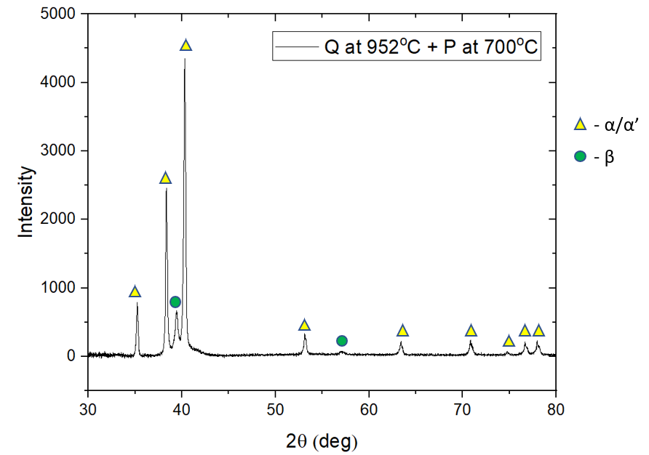
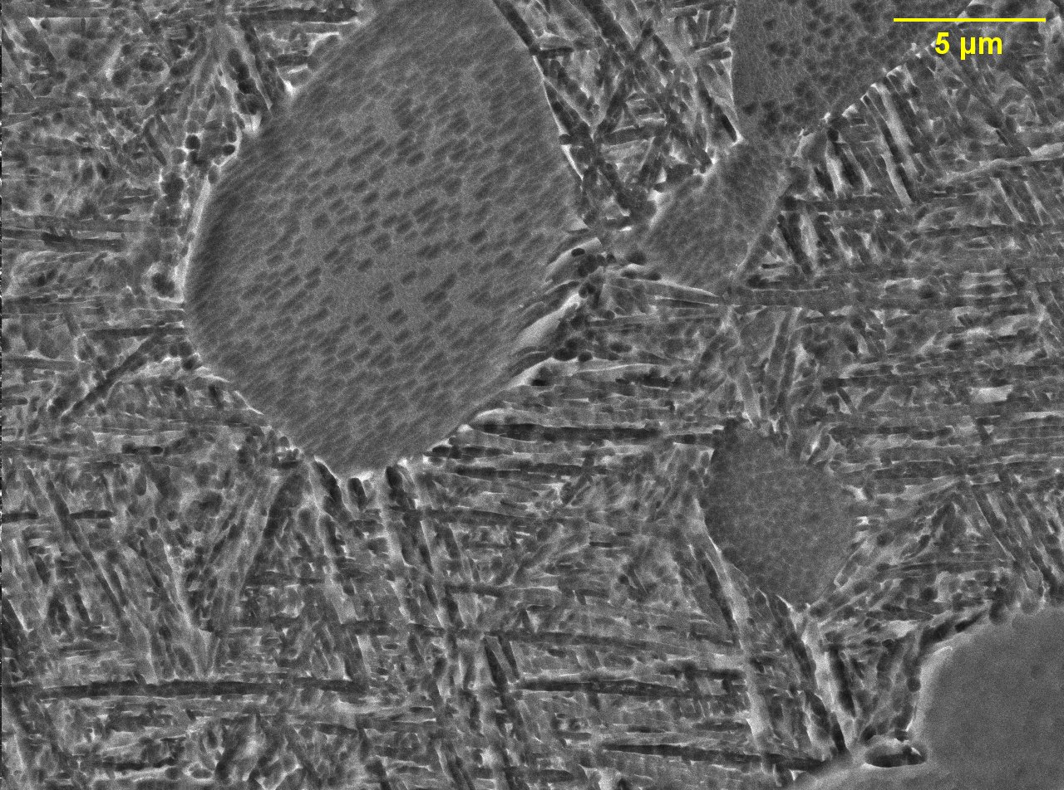
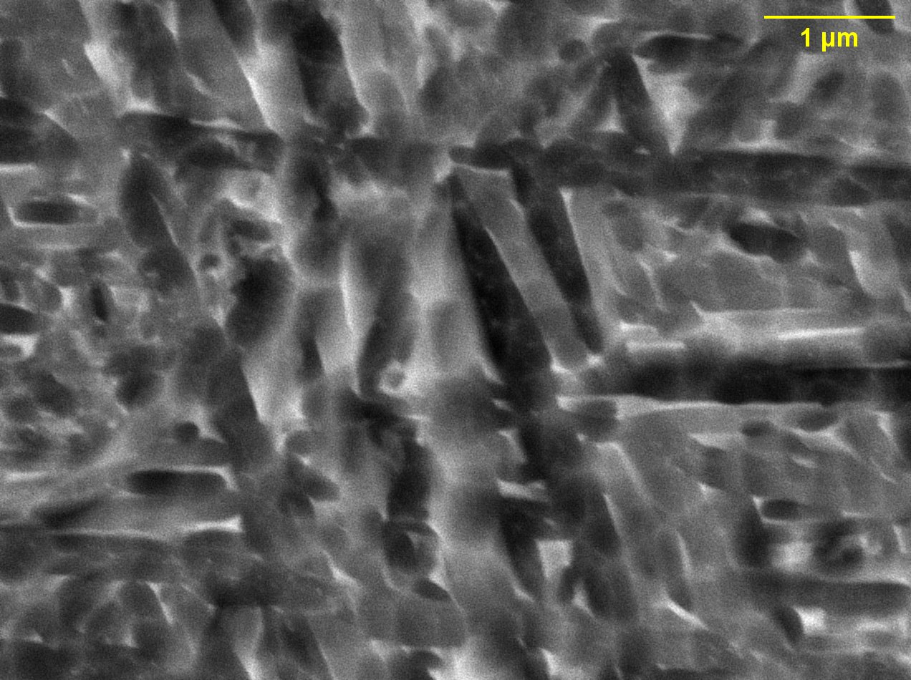
Quenching at 952°C + Partitioning at 700°C
Decomposition of α’-phase
Fine lamellae of α+β
XRD peak of β-phase evident
Complete decomposition of α’ into fine lamellar α+β
(110)
(200)

Slide 17
Take-aways
Inter-critical annealing
UTS increases with α’ phase fraction
Maximum strain hardening achieved at 50% α’ phase fraction
Partitioning
α’ decomposition starts at 600°C
Complete decomposition of α’ after partitioning at 700°C
(200)
(110)
(110)
(110)

Slide 18
Work Plan and Progress

Slide 19
Challenges and Opportunities
Quantitative microstructural characterization after partitioning
SEM imaging and XRD analysis only present qualitative evidence for partitioning
SEM-EDS and EBSD cannot be used to characterize sub-micron scale partitioning
Potential solution: Use of TEM EDS or APT

Slide 20
Future Work
Wrought and AM Ti-6Al-4V
Determine the partitioning parameters for the as-quenched material using simulation tools and heat treatments
Conduct mechanical characterization on the partitioned samples with desired microstructures
Understand the structure-property relationship of this alloy after quenching and partitioning
Heat treatments on β-Ti alloys
Thank you!
Valava Sambandam Rani
valavasambandamrani@mines.edu

Slide 21
References
[1] O. Dumas , B. Hary , G. Martin , F. Sun , C. de Formanoir , F. Prima , S. Godet, Towards work-hardenability of Ti-6Al-4V through a quenching and partitioning approach, MATEC Web of Conferences 321, 11062 (2020)
[2] Charlotte de Formanoir, Guilhem Martin, Frédéric Prima, Sébastien Allain, Thibaut Dessolier, Fan Sun, Solange Vivès, Benjamin Hary, Yves Bréchet, Stéphane Godet, Micromechanical behavior and thermal stability of a dual-phase α+α’ titanium alloy produced by additive manufacturing, Acta Materialia (2018)
[3] Chafino, J.A., Yamanaka, K., Mercier, F., Rivory, P., Balvay, S., Hartmann, D.J., Chiba, A., Fabregue, D., The influence of temperature during water-quench rapid heat treatment on the microstructure, mechanical properties and biocompatibility of Ti -6Al -4V ELI alloy, Journal of the Mechanical Behavior of Biomedical Materials (2019)
[4] Charlotte de Formanoir, Alice Brulard, Solange Vivès, Guilhem Martin, Frédéric Prima, Sébastien Michotte, Edouard Rivière, Adrien Dolimont & Stéphane Godet, A strategy to improve the work-hardening behavior of Ti–6Al–4V parts produced by additive manufacturing, Materials Research Letters, 5:3, 201-208 (2017)
[5] W. Xu, M. Brandt, S. Sun, J. Elambasseril, Q. Liu, K. Latham, K. Xia and M. Qian, Additive manufacturing of strong and ductile Ti–6Al–4V by selective laser melting via in situ martensite decomposition, Acta Materialia, 85, 74–84 (2015)

